Slide 1

ICT trends in scientometrics and their impact on the academia
Sándor Soós
¹Hungarian Academy of Sciences (MTA), Budapest, Hungary

Slide 2


Scientometrics as a research field
By definition: „The quantitative study of scientific communication”
Björneborg & Ingewersen, 2004

Slide 3
Methodological frameworks in Scientometrics
Sciento-
metrics
(…)
Information science
Computer science
Statistics
Econo-
Metrics
Network
science
Economics

Slide 4
Research directions in Scientometrics
Scientometrics
Structural
Dynamics, development, structure of S&T (cognitive, social level)
Evaluative
Models and measurement of research performance
Field
Direction
Research program

Slide 5
First wave: two levels of bibliometrics
Science Citation Index (SCI)
  1961, Institute of Scientific Information, Eugene Garfield
Journal Citation Report (SCI)
  SCI-derivative, 1975, Impact Factor (IF), 1955 Eugene Garfield
Web of Science (WoS)
  On-line platform for SCI (+JCR), 2001
Early stage: study of the „development and direction of scientific research, rather than to evaluate its quality” (Wouters et al. HEFCE, 2015) > Professional bibliometrics
„Nevertheless, the SCI’s success did not stem from its primary function as a search engine, but from its use as an instrument for measuring scientific productivity, made possible by the advent of its by-product, the SCI Journal Citation Reports (JCR) and its Impact Factor rankings.” (Garfield, 2010) > Citizen bibliometrics

Slide 6
Emergence of „citizen bibliometrics”
Recognition of the potential in research evaluation (Policy): 1980’s, 1990’s
„Big” data availability
Quick utilization in research administration
BUT
Lack of an underlying theory of performance (impact):
„And with the creation of the Science Citation Index, the field of bibliometrics and the use of citation analysis in research evaluation have been driven by the availability of data to the point that it has come to shape the definition of scientific impact.” (Haustein, 2016)
„Policy pull + Data push”

Slide 7
First wave: „theory-unladenness”
Scientific impact
Sociology of science:
Theory of citation
# citations, IF, …
Performance dimension
Theoretical level
Indicators (measurement)

Slide 8
Characterization of „citizen bibliometrics”
„Citizen bibliometrics”: bibliometrics-based evaluation activity carried out by non-experts (mostly in science administration)
Category mistakes (JIF misuse in author (individual) evaluations, „aggregate IF”)
Blind application (context and problem-insensitive)
Comparing apples with oranges (raw, unnormalized, size-dependent etc. Indicators)
Single-number obsession (Hirsch-index)
Metric-based evaluation absolutized
Wave 2 further characteristics
Selective on access (commercialized indicators vs. Open access indicators)
Conservative (IF, Hirsch, raw cit count „obsession”)
Self-service
Theoretically non-grounded or not sound
Decontextualized (mechanistic application of metrics, not fitted to the assessment problem)

Slide 9
First wave effect: responses within academia
Pressure and strategic behavior in response to the „IF and Hirsch culture”
Goal displacement
Task reduction
Salami publishing
Strategic collaborations (to boost individual metrics) : farm citations
Gaming
Hiring of researchers
Declarations: DORA , „The San Francisco Declaration on Research Assessment (DORA), initiated at the 2012 Annual Meeting of the American Society for Cell Biology by a group of editors and publishers of scholarly journals, recognizes the need to improve the ways in which the outputs of scientific research are evaluated.”

Slide 10
First wave effect: responses within academia

Slide 11
Meanwhile in professional bibliometrics
Scientific impact
Sociology of science: theory of citation
# citations, IF, …
Statistical models of the citation process
Normalized, „model-based” impact metrics
Performance dimension
Theoretical level
Indicators (measurement)

Slide 12
Meanwhile in professional bibliometrics
Scientific impact
Statistical characterization of citation distributions
Models of citation dynamics
Main factors of citedness (for papers): fields, doctypes, age
Normalization for factors
Normalized indicators (MNCS, PP10% etc.)
Output and productivity
Size dependencies
Activity indexes
Collaboration
Co-authorship indicators
Quality
Journal metrics (SJR, SNIP, Eigenfactor, AIS etc.)
Profile
Interdisciplinarity metrics (IDR)
Dimensions of performance and Commensurability

Slide 13
Second wave: Metrics services
2004: Scopus (Elsevier) and Google Scholar (Google)
Related on-line metrics services (open access)
Publish or Perish (Anne Harzing) on Google Scholar data
Hirsch index and derivatives (e-index, g-index, Hl-index etc.)
  Correcting the Hirsch index for various known biases
Scimago Journal and Country Rank (Scimago Group, Uni Granada, Spain)
SJR metric and its Quartile-based presentation
  new quality dimension and more sound cross-field comparisons
Initial infiltrations of professional bibliometrics

Slide 14
Second wave: Professional metrics services
ISI Thomson Reurters: InCites „research analytics” tool (WoS-based)
Elsevier SciVal „research analytics” tool (Scopus-based)
On-line metrics services
Subscription-based
„Commertionalization” of professional bibliometrics

Slide 15
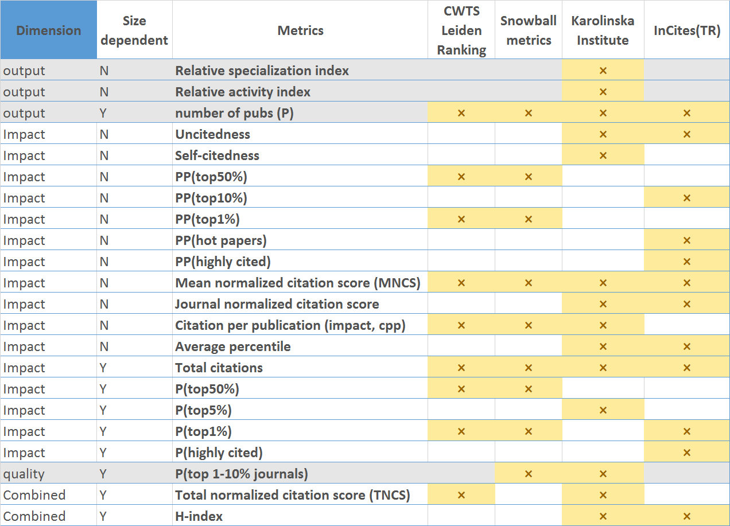
Second wave: Professional metrics services

Slide 16
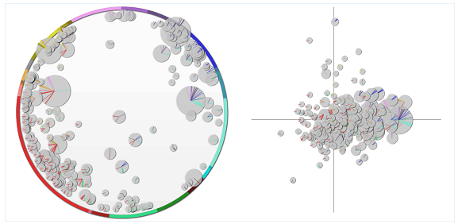
Second wave: Professional metrics services
Scival: „Map of research competences”
Science mapping -> „Strategic research intelligence”

Slide 17
Wave2 outcome: citizen bibliometrics 2.0
„Citizen bibliometrics”: bibliometrics-based evaluation activity carried out by non-experts (mostly in science administration)
Category mistakes (JIF misuse in author (individual) evaluations, „aggregate IF”)
Blind application (context and problem-insensitive)
Comparing apples with oranges (raw, unnormalized, size-dependent etc. Indicators)
Single-number obsession (Hirsch-index)
Metric-based evaluation absolutized
Wave 2 potential unexpected outcomes (professional tools „unleashed”)
Selective on access (commercialized indicators vs. Open access indicators)
Diversity not accomodated: selective on usage
Conservative (IF, Hirsch, raw cit count „obsession”)
Self-service (commensurability violated)
Theoretically non-grounded or not sound
Decontextualized due to misinterpreted „professionalism” (mechanistic application of metrics, not fitted to the assessment problem)

Slide 18
Wave2 outcome: responses within academia
Pressure and strategic behavior in response to the „metrics culture”
Goal displacement
Task reduction
Salami publishing
Strategic collaborations (to boost individual metrics) : farm citations
Gaming
Hiring of researchers
Confusion concerning „publication strategies” (SJR or IF Q1?)
Trust issues: transparency and communicability reduced

Slide 19
Wave2: ALTmetrics
Altmetrics: response to the challenges of classical bibliomerics
Predecessor: Webometrics (usage and on-line „referencing” of scholarly content on the Web as alternative impact measuement)
Focus of Altmetrics: on-line „social” acts related to scholarly content on the web as impact indication (detected posts, blogs, reads etc.)
Priem et al. 2010: ALTMETRICS manifesto
Main hypothesized benefits:
  Much broader range and more dimensions of impact (social impact!)
  No delay in impact manifestation (citations need years to accrue…)
  Big data
  Much wider coverage than citation databases: a fair business for SSH fields as well

Slide 20
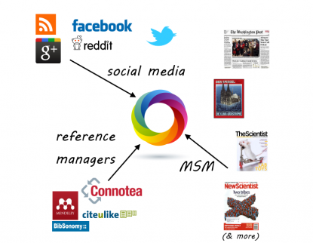
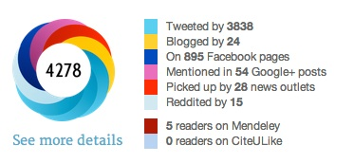
ALTmetrics: Metrics services
„Big data” and technology opportunities

Slide 21
ALTmetrics vs. professional bibliometrics
Scientific impact
Sociology of science: theory of usage
Access, appraise, apply counts
Statistical models of usage
Normalized, „model-based” impact metrics
Performance dimension
Theoretical level
Indicators (measurement)
Haustein, S. (2016). Grand challenges in altmetrics: heterogeneity, data quality and dependencies. Scientometrics, 108(1), 413-423.
Plus: data quality (e.g. persistence)

Slide 22
ALTmetrics: social impact (Scientometrics 2.0)
Policy push: the measurement of social impact
Is ALTmetrics the answer?
Wouters et al., HEFCE, 2015

Slide 23
Summing up: history repeating
First wave
Policy push
Data supply (ISI, WoS)
Second wave
Professional bibliometrics
Data and ICT supply (Scopus, GS, WoS, tools, services, ALTmetrics)
Citizen bibliometrics
Strategic behavior
Citizen bibliometrics
Strategic behavior

Slide 24
Way out: good (collaborative) practices
Hicks, D., Wouters, P., Waltman, L., De Rijcke, S., & Rafols, I. (2015). The Leiden Manifesto for research metrics. Nature, 520(7548), 429.

