Slide 1

Embedding InCites into a diverse assessment environment: the case of MTA KIK TTO
Sándor Soós¹
¹Hungarian Academy of Sciences (MTA), Budapest, Hungary
²Petabyte Research Ltd., Budapest, Hungary

Slide 2




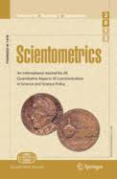

MTA KIK Dept. of Sci. Pol. And Scientometrics

Slide 3


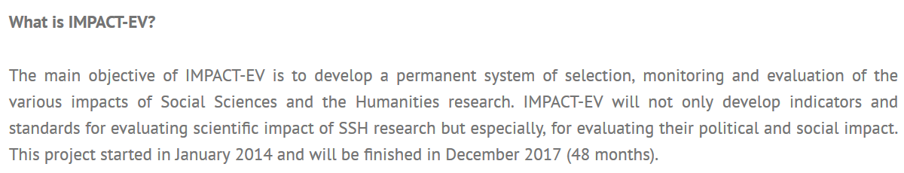

Research projects
The IMPACT-EV project (FP7)
Dedicated task: To develop/construct a feasible indicator system for monitoring the scientific impact of European funded research projects

Slide 4
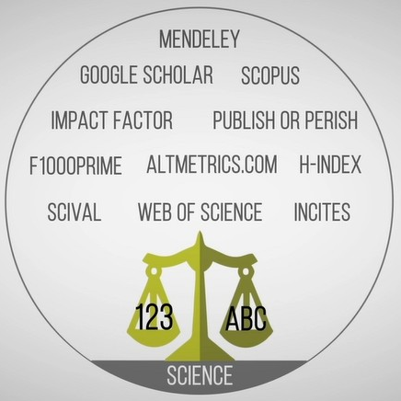
InCites for: (1) Promoting best practice in evaluation
Diverse actors in research evaluation:
Academia
Stakeholders (policy making)
Data providers
Science analytics business
Ranking business
Research institutions and groups (CWTS)
(…)

Slide 5
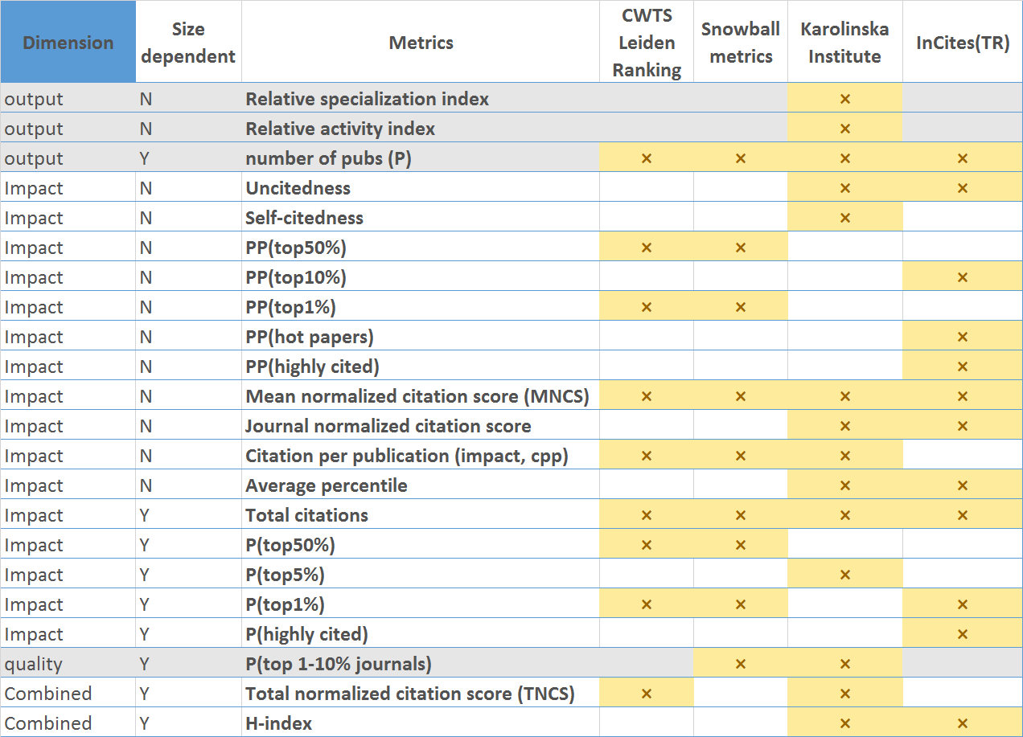
InCites for: (1) Promoting best practice in evaluation

Slide 6
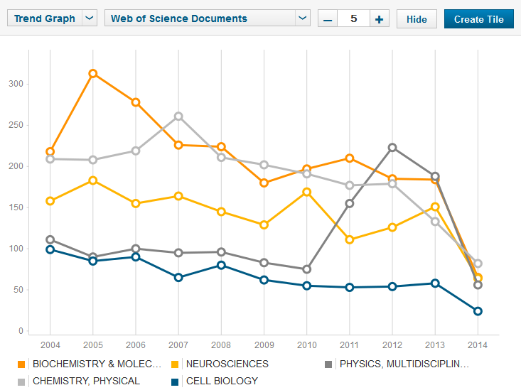
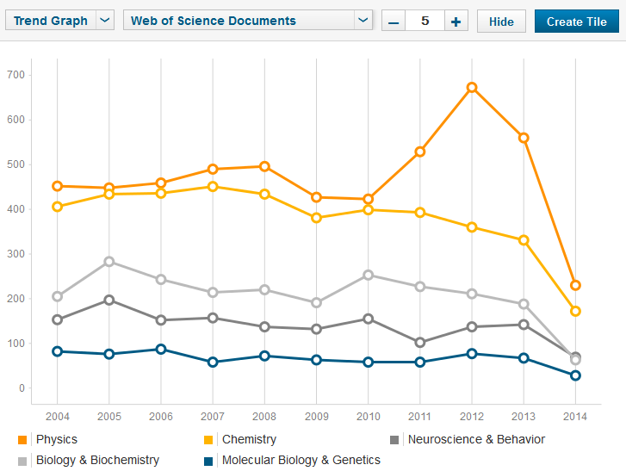
InCites for: (1) Educating on context-sensitivity in evaluation

Slide 7

InCites for: (2) Enabling evaluation methods
InCites
Field benchmarks for normalization (comparability)
Cross-validadated data (affiliations)
Web of Science
Validated data: cross-validating with national databases (MTMT)
MTMT

Slide 8
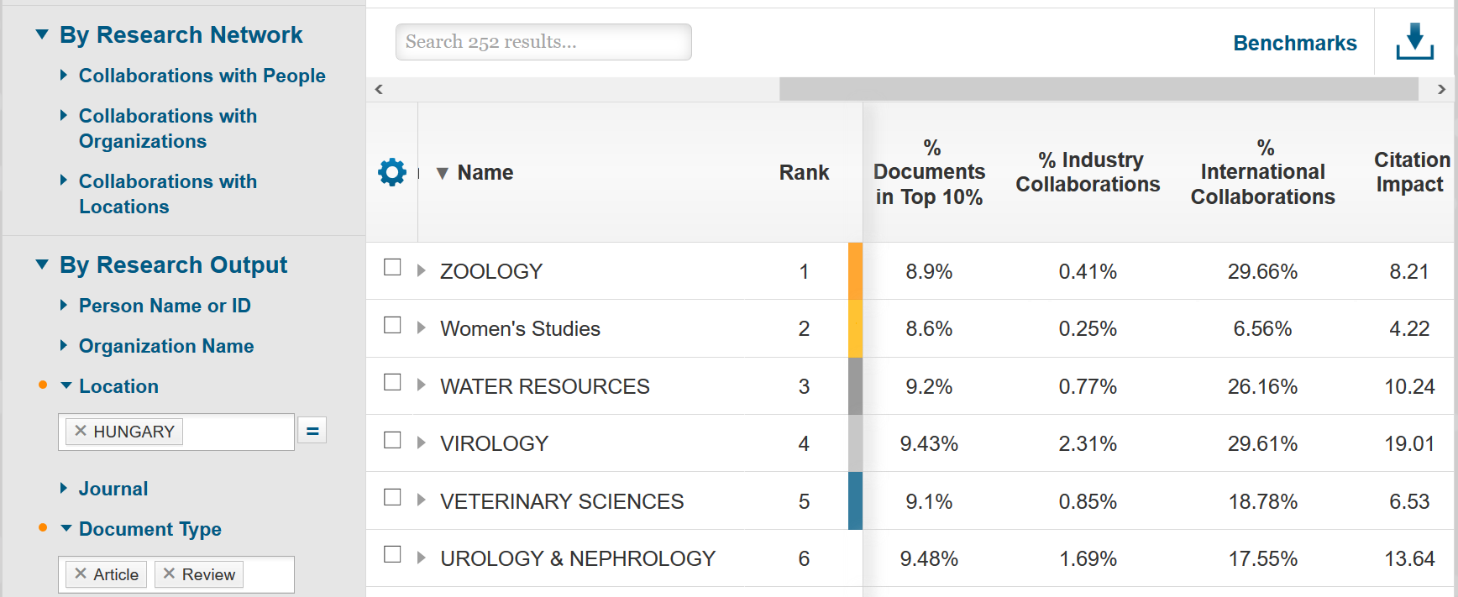
InCites for: (2) Enabling evaluation methods
Validated data: cross-validating with national databases (MTMT)

Slide 9
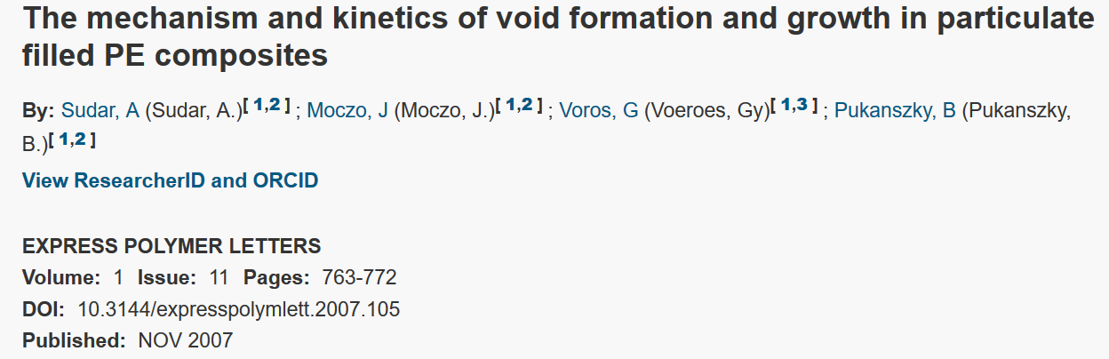
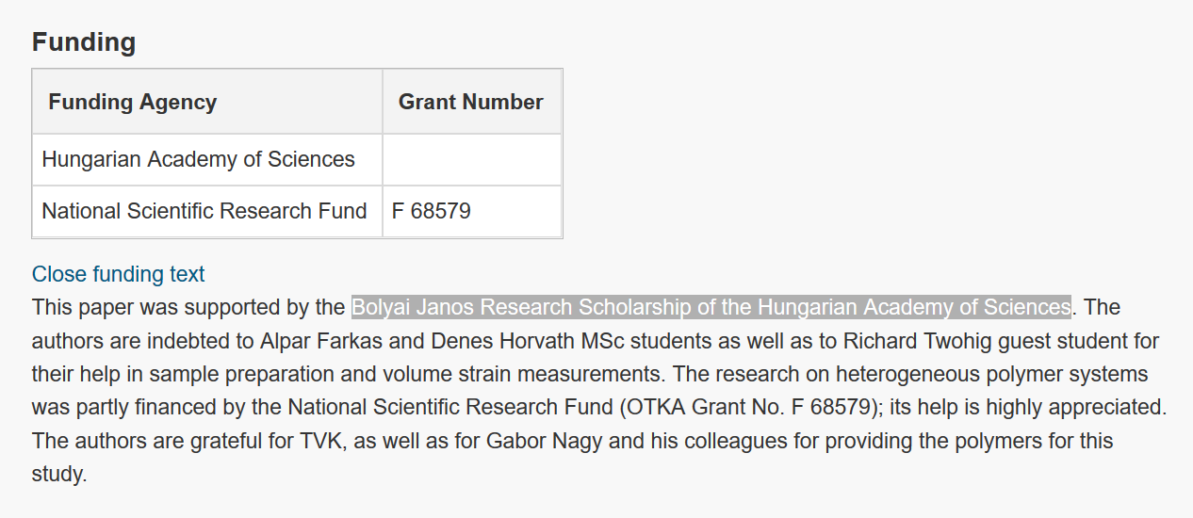
InCites for: (2) Enabling evaluation methods
Custom data: data mining for detecting publication sets (e.g. evaluating funding systems)

Slide 10
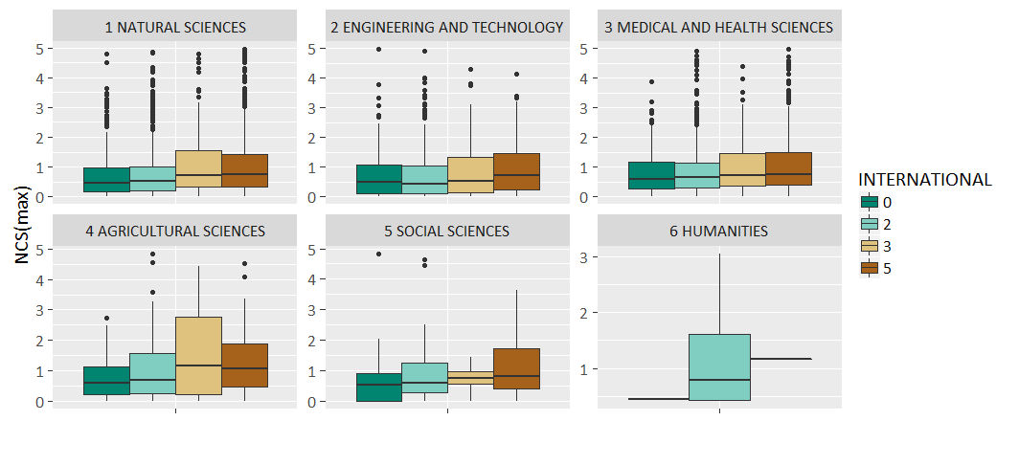
InCites for: (2) Enabling evaluation methods
Custom analyses: Item (paper-) -level characteristics for the study or distributions in the metrics space

Slide 11
Some issues w.r.t. evaluation
„Marketing” decisions for metrics design:
% pubs in Q1 journals.
  How Category assignments are factored in : Best Q!
Average JIF percentile
  How Category assignments are factored in: Best rank!
Switching between classification schemes
  How things add up in the new scheme (e.g. MNCS calculation based on which reference sets?)

Slide 12
Some issues w.r.t. evaluation
„Marketing” decisions for metrics design:
% pubs in Q1 journals.
  How Category assignments are factored in : Best Q!
Average JIF percentile
  How Category assignments are factored in: Best rank!
Switching between classification schemes
  How things add up in the new scheme (e.g. MNCS calculation based on which reference sets?)

Slide 13
InCites workshop, Vienna, 2017. 11. 09.
Thank you you for your attention!

