Slide 1
A Context Sensitive
Searching and Ranking
  Scientometrics (2016) 108:653–671
  DOI 10.1007/s11192-016-1982-6
Haluk O. Bingol
Dept. of Computer Engineering
Bogazici University,
Istanbul
Budapest, 30.09.2016
COST TD1210
© 2016 bingol

Slide 2
Outline
Motivation
Theory
  Information Retrieval
  Linked Documents
  Citation Graphs
Our Approach
Examples
Status

Slide 3
Motivation

Slide 4
  Motivation
Better search “related” documents
Better “rank” them

Slide 5
Searching and Ranking

Slide 6
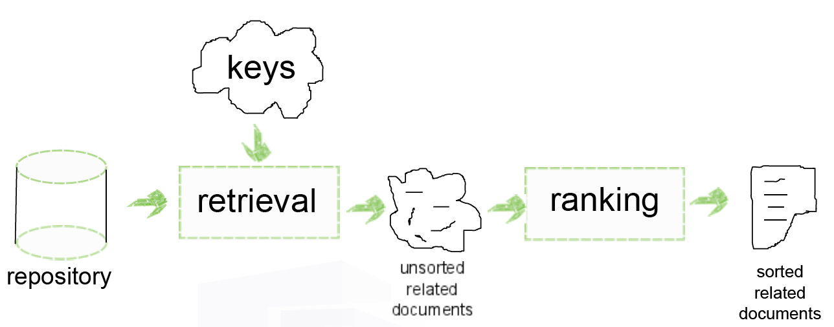
Searching and Ranking
You
Give me what I want
System
Tell me what you want
I will give you
  what I found
  in an order

Slide 7
Searching and Ranking
Problem Definition
Given
  Document repository
  Keys
Wanted
  related documents
  ranked
Ranked in
  Relatedness
  Correctness
  …

Slide 8
Searching and Ranking
Keys
“what I want” described by keys
  Exact terms
  Similar/related terms
  Concepts
  Potential words

Slide 9
Searching and Ranking
Repository
Collection of documents

Slide 10
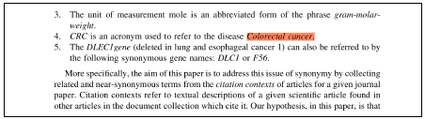
Searching and Ranking
Unstructured (unlinked) Documents
Full text search
  Abstract
  Keywords
  Document
Problems
  Examples
  New interpretation
    Coined later

Slide 11
Linked Documents

Slide 12
Linked Documents
Cited documents
  Scientific papers
  Web pages
  Law docs
  Patent docs
  Newly created docs
    e-Doc
  …
Implies
  directed graph
Used
  In ranking
    Google PageRank
    HITS
    …
    Ours
  Citation context
    …
    Ours

Slide 13
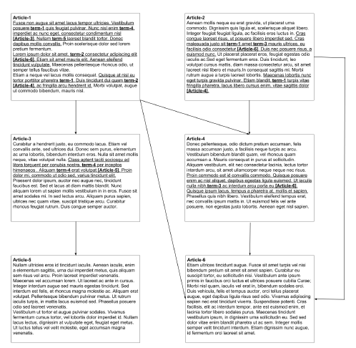
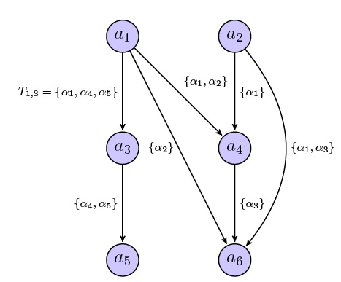
Linked Documents
Directed Graph
Cited documents
  Scientific papers
  Web pages
  Law docs
  Patent docs
  …
Implies
  directed graph
Used
  In ranking
    Google PageRank
    HITS
    …
    Ours
  Citation context
    …
    Ours

Slide 14
Citation Graphs

Slide 15
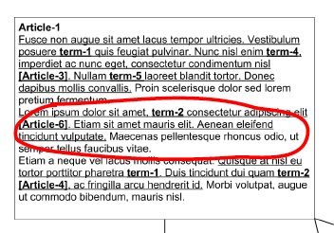
Citation Graphs
Citation Context
Cited documents
  Scientific papers
  Web pages
  Law docs
  Patent docs
  …
Citation contains information about
  Cited document

Slide 16
Citation Graphs
Citation Terms
Use citation context
Identify terms
Citation contains information about
  Cited document
  Crowd sourcing
    You are what people think you are

Slide 17
Citation Graphs
Term Graphs
Use citation context
Identify terms
Label links with terms

Slide 18
Citation Graphs
Use for Retrieval
Use citation context
Identify terms
Label links with terms
Use terms for retrieval

Slide 19
Our Approach

Slide 20
Our Approach
…
Label links with terms
Use terms for retrieval

Slide 21
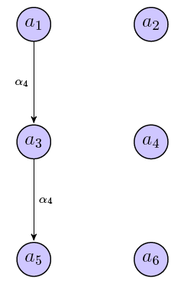
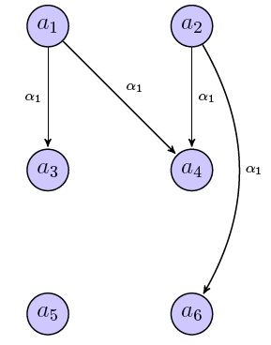
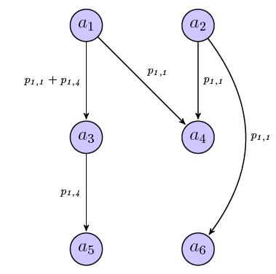
Our Approach
Term Specific Graphs
…
Label links with terms
  Term specific graphs

Slide 22
Our Approach
Term Specific Graphs
…
Label links with terms
  Term specific graphs
Use terms for
  Retrieve docs
  Define similarity in terms
  Retrieve docs with similar terms, too

Slide 23
Our Approach
Term Specific Graphs
…
Label links with terms
  Term specific graphs
Use terms for
  Retrieve docs
  Define similarity in terms
  Retrieve docs with similar terms, too
  Rank in new graph
New set
Original Term
Similar Terms
New Ranking
new graph

Slide 24
Examples

Slide 25
Examples
Document does not contain the term: “Hadoop”
“Hadoop” was derived from
  Google File System (GFS) [Ghemawat2003]
  Google's MapReduce [Dean2004]
  while Hadoop term is coined in 2005
Search for
  “hadoop”
We get
  [Ghemawat2003] and [Dean2004]
Google scholar
  Does not

Slide 26
Examples
Document does not contain the term: “Hadoop”
“Hadoop” was derived from
  Google File System (GFS) [Ghemawat2003]
  Google's MapReduce [Dean2004]
  while Hadoop term is coined in 2005
Search for
  “hadoop”
We get
  [Ghemawat2003] and [Dean2004]
Google scholar
  Does not

Slide 27
  Examples
  Similar term: “power law”
Search for
  “power law”
We get
  “Collective Dynamics of ‘small-world’ Networks” [Watts1998]
Google scholar
  Does not

Slide 28
  Examples
  Similar term: “power law”
Search for
  “power law”
We get
  “Collective Dynamics of ‘small-world’ Networks” [Watts1998]
Google scholar
  Does not

Slide 29
Status

Slide 30
Status
Paper
  Context sensitive article ranking with citation context analysis
  Metin Doslu and Haluk O. Bingol
  Scientometrics (2016) 108:653–671
  DOI 10.1007/s11192-016-1982-6
Patent applied

Slide 31
Summary
Information Retrieval
Linked Documents
Citation Graphs
Citation Context Graphs
Our Approach
Examples
Status
Key points
Increase unsorted, related documents set
Use term specific graph for ranking
  Context sensitive article ranking with citation context analysis
  Metin Doslu and Haluk O. Bingol
  Scientometrics (2016) 108:653–671
  DOI 10.1007/s11192-016-1982-6

