Slide 1






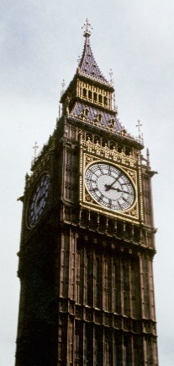
The Location of Papers in Topic Space-Time
http://knowescape.org/
“Identification, location and temporal evolution of topics” meeting, Part of COST Action TD1210 KNOWeSCAPE
Budapest August 29-30, 2016.
Tim Evans
Centre for Complexity Science
Social and Cultural Analytics Lab
Work done with: James CLOUGH
pronounced CLUFF
Notes:
“Identification, location and temporal evolution of topics” meeting,
Part of COST Action TD1210 Knowescape http://knowescape.org/
Library and Information, Centre of the Hungarian, Academy of Sciences, Arany János st. 1, 1051, Budapest
29-30 August 2016
Started from TimEvans-DAG-CANES-KCL2016.pptx which was based on earlier talks:
1) DOI: 10.6084/m9.figshare.1464980
2) Network Geometry workshop, QMUL 16th July 2015, http://ginestra-bianconi-6flt.squarespace.com/
3) Open Workshop by the EU FP7 CONGAS collaboration, Imperial, 9th June 2015
4) James Clough talks on LMDS e.g. NetSci-X January 2016, Wroclaw, Poland.
For “Identification, location and temporal evolution of topics” meeting, Budapest August 29-30, 2016. Part of COST Action TD1210 Knowescape, and the FP7 Project Impact-EV.
Original Title: The Location of Papers in Topic Space-Time.
Abstract: Many standard tools for the analysis of large data sets place data points in a natural space measuring distance in the intuitive way we use every day. However publications are characterised both by a position in some topic space and by a publication date. This suggests that we should use analysis tools which are aware of time and the difference in the geometry of space and time. Mathematics shows that the change from the simple spaces underlying traditional data analysis tools to space-times involves a fundamental change to the geometry which in turn brings new types of distance measures. I will show how we have adapted standard MDS (Multi-Dimensional Scaling) methods to take account of the direction of time allowing us to estimate the time and space location of vertices in a citation network (or any directed acyclic graph) from the network connections alone. I will use simple toy models to demonstrate the effectiveness of the method. I will then use our method to assign space and time coordinates to papers in an arXiv.org citation network which will reveal both topics and their evolution in a natural way.

Slide 2
Time & Networks
Netometry – Networks & Geometry
Dimension
Coordinate Assignment
Summary

Slide 3
Networks
Network = Vertices + Edges

Slide 4
Timed Edges = Temporal Edge Networks
Communication Networks
Email
Phone
Letters
Focus of much recent work
[Holme & Saramäki 2012,
Lambiotte & Masuda 2016]
Notes:
as in review by Holme & Saramäki, Temporal Networks 2012

Slide 5
Timed Vertices = Temporal Vertex Networks
Each vertex represents one event occurring at one time
⇒Time constrains flows
Directed edges point in
one direction only
No loops

Slide 6

Timed Vertices = Temporal Vertex Networks
Each vertex represents one event occurring at one time
Directed Acyclic Graph (DAG)
→ Computer Science
Poset (partially ordered set)
→ Discrete Mathematics
i
$$i ≽ j$$
j

Slide 7
Applications - Flows
Flow of Ideas & Innovations:
Citation Networks
  papers, patents, court judgements
Flow of Projects
  management of tasks, critical paths
Flow of Mathematical Logic
  spreadsheet formulae
Flow of Space-Time Causality
  Causal Set approach to quantum gravity

Slide 8

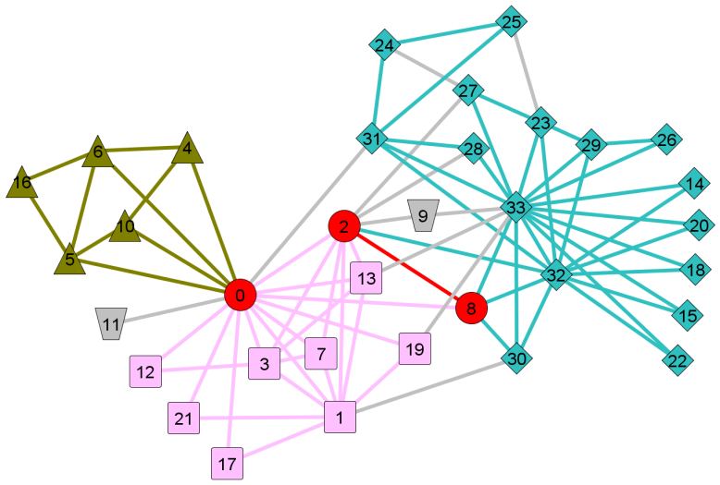
My Thesis
Constrained
Network
New Network Methods

Slide 9
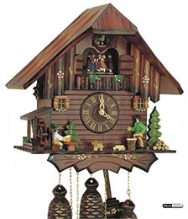
Causality and Networks
Time Constraint on Vertices
New Methods for
Temporal Vertex Networks
Dimension
Geometry
Transitive Reduction
Clough, Gollings, Loach, Evans 2015
Longest Path

Slide 10
Time & Networks
Netometry – Networks & Geometry
Dimension
Coordinate Assignment
Summary

Slide 11

Networks and Geometry
Standard tools for data and network analysis use Euclidean space where distance L is
e.g.
Wireless Networks, RGG etc.
Network Visualisations
Dimensional Reduction of Data
  MDS (Multidimensional Scaling)
  PCA (Principal Component Analysis)
$$L^{2}=x^{2}+y^{2}+z^{2}+…$$
Karate Club
[Evans 2010]
Notes:
Figure karateTSECPt2c3l500editB.graphML.png
taken from
Evans, T.S.
Clique Graphs and Overlapping Communities
J.Stat.Mech, Imperial/TP/10/TSE/02, 2010, P12037

Slide 12
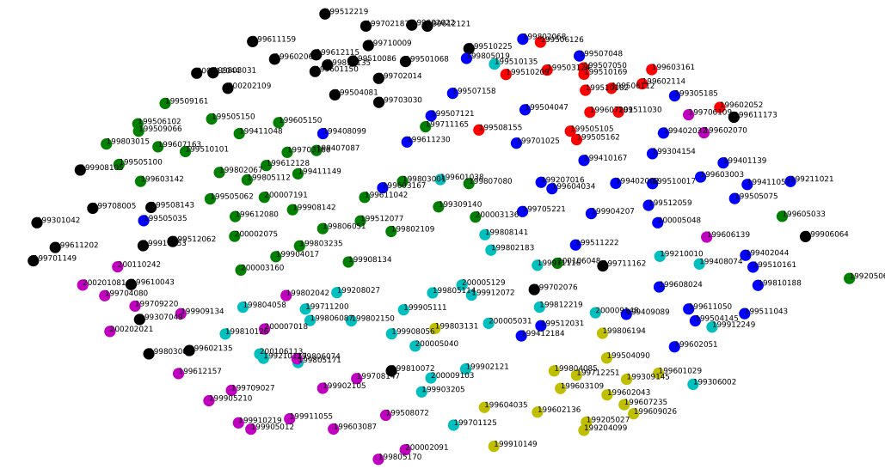
MDS Clustering
Standard clustering tool using usual Euclidean distance measures
Colours:
8 k-means
clusters
KDD cup
arXiv hep-th 1992-2003
Abstract text similarity and MDS
Notes:
Screen shot of *_hep-th_200_embedding_cl008_scatter.pdf file produced in KDDanalysis and sent in email 24/8/16 at 17:36
KDD cup arXiv hep-th 1992-2003 data. Text similarity on abstracts using standard tfidf, MDS for coordinates, hierarchical clustering (Ward?) with 8 clusters for colours. All produced with KDDanalysis python project.
Papers close in plot ought to be similar as suggested by the hierarchical clustering colours

Slide 13
Clusters vs Coordinates
No visually distinct clusters suggests continuous coordinates better than discrete categories
Colours:
8 k-means
clusters
KDD cup
arXiv hep-th 1992-2003
Abstract text similarity and MDS
Notes:
Screen shot of *_hep-th_200_embedding_cl008_scatter.pdf file produced in KDDanalysis and sent in email 24/8/16 at 17:36
KDD cup arXiv hep-th 1992-2003 data. Text similarity on abstracts using standard tfidf, MDS for coordinates, hierarchical clustering (Ward?) with 8 clusters for colours. All produced with KDDanalysis python project.
Papers close in plot ought to be similar as suggested by the hierarchical clustering colours

Slide 14
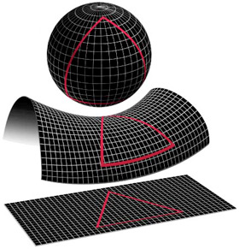
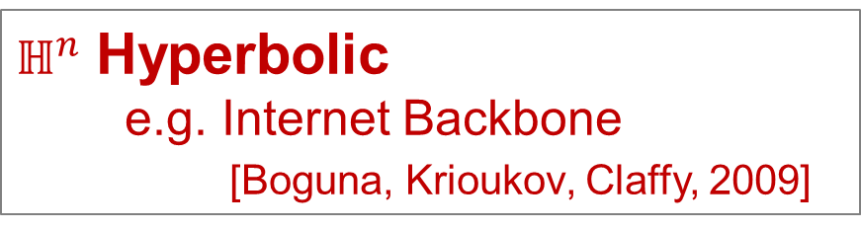


Networks and Geometry
Recent work goes beyond simple Euclidean space
$𝕊^{n}$ Sphere
e.g. clustering population, air travel
$ℍ^{n}$ Hyperbolic
e.g. Internet Backbone
[Boguna, Krioukov, Claffy, 2009]
$ℝ^{n}$ “Flat” Euclidean
Standard MDS
Notes:
Krioukov, D.; Kitsak, M.; Sinkovits, R. S.; Rideout, D.; Meyer, D. & Boguna, M.
Network Cosmology
Nature Scientific Reports, 2012, 2, 793
Boguna, M.; Krioukov, D. & Claffy, K. C.
Navigability of complex networks
Nat Phys,, 2009, 5, 74-80

Slide 15


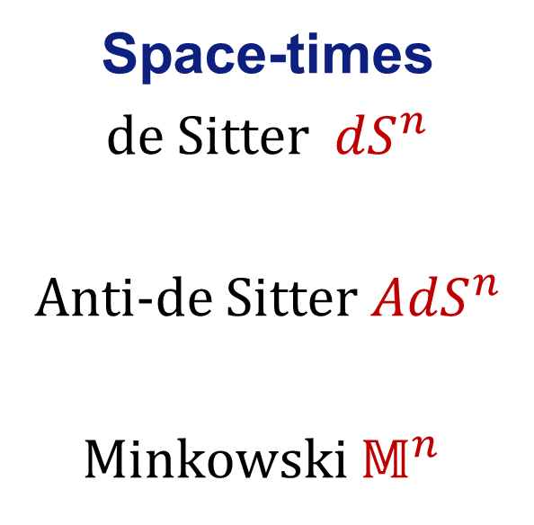
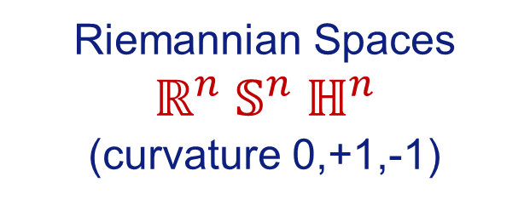
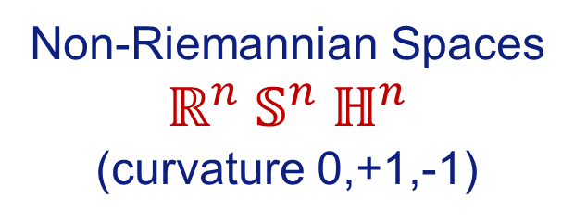

Networks, Geometry and Time
Very little clustering work includes time
Space-times
de Sitter ${dS}^{n}$
Anti-de Sitter${AdS}^{n}$
Minkowski $𝕄^{n}$
$$𝕊^{n}$$
$$ℍ^{n}$$
$$ℝ^{n}$$
Riemannian Spaces $ℝ^{n} 𝕊^{n} ℍ^{n}$
(curvature 0,+1,-1)
Non-Riemannian Spaces $ℝ^{n} 𝕊^{n} ℍ^{n}$
(curvature 0,+1,-1)
Notes:
Krioukov, D.; Kitsak, M.; Sinkovits, R. S.; Rideout, D.; Meyer, D. & Boguna, M.
Network Cosmology
Nature Scientific Reports, 2012, 2, 793
Boguna, M.; Krioukov, D. & Claffy, K. C.
Navigability of complex networks
Nat Phys,, 2009, 5, 74-80

Slide 16
Minkowskii Space
My approach is to use simplest space-time
Minkowski space
in D = (d+1) space-time dimensions
$$L^{2}=t^{2}−x^{2}−y^{2}−z^{2}−…$$
[Clough & Evans, Physica A 2016 (arXiv:1408.1274);
ISSI 2015 Proceedings, arXiv:1507.01388;
arXiv:1602.03103]
Notes:
Clough, J. & Evans, T.
What is the dimension of citation space?
Physica A 2016 (to appear) [http://arxiv.org/abs/1408.1274]
Clough, J. & Evans, T.S.
Salah, A. A.; Tonta, Y.; Salah, A. A. A.; Sugimoto, C. & Al, U. (Eds.)
Time and Citation Networks
Proceedings of ISSI 2015 Istanbul: 15th International Society of Scientometrics and Informetrics Conference, Istanbul, Turkey, 29 June to 3 July, 2015, 2015, 1073-1078 [http://arxiv.org/abs/1507.01388]

Slide 17
Minkowski Space
Future
time-like
region
y
Measure spatial distance in terms of time to reach that point
  c.f. light years
Information flows into forward light cone only
TIME
Space-like
region
x
Space-like
region
Past
time-like
region
SPACE

Slide 18

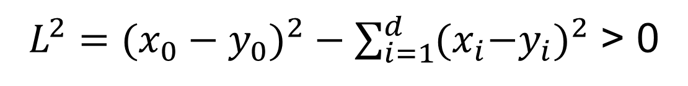
Causal Set - Null Model
Transitively
complete
y
Future
PPP in D-dimensional space
Take one dimension as time
Add edge from point x to and y if
and time-like separation
Space-
Like
x
Space-
Like
$$x_{0}<y_{0}$$
Past
$L^{2}=({x_{0}−y_{0})}^{2}−\sum_{i=1}^{d}{{{(x}_{i}{−y}_{i})}^{2}}$ > 0
Standard model used in
Discrete maths e.g. Bollobás & Brightwell 1991
Causal set quantum gravity e.g. see Dowker 2006

Slide 19
Time & Networks
Netometry – Networks & Geometry
Dimension
Coordinate Assignment
Summary

Slide 20
Dimension for Social DAG Spacetime
Formulae used derived for Causal Set Null Model
= PPP (Poisson Point Process)
in Minowkski space
e.g. volume ~ (length scale)^{Dimension}
Do they work for social DAG networks?

Slide 21
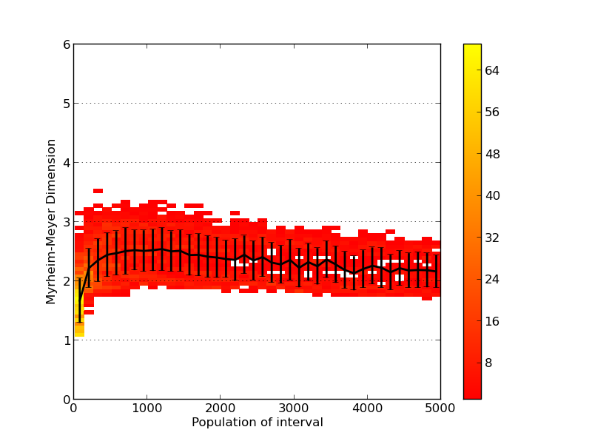
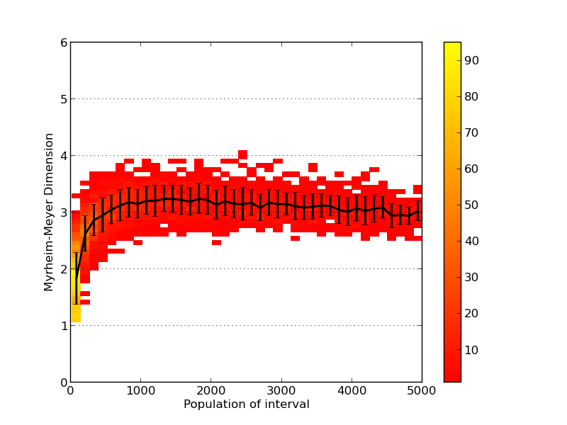
Comparison of Data Sources
[Clough & Evans 2016,
arXiv:1408.1274 ]
String Theory
hep-th arXiv
Particle Phenonemology
hep-ph arXiv
# runs
D=3
MM Dimension
MM Dimension
D=2
N
# nodes in interval
N
# nodes in interval
Notes:
The different methods are consistent

Slide 22
Dimensions
[Clough & Evans 2016,
arXiv:1408.1274 ]
Data | Dimension
hep-th (String Theory) | 2
hep-ph (Particle Physics) | 3
quant-ph (quantum physics) | 3
astro-ph (astrophysics) | 3.5
US Patents | >4
US Supreme Court Judgments | 3 (short times), 2 (long times)
String theory appears to be a narrow field
Notes:
Crudely, the `dimension' of the hep-th network appears to be around 2, and the
hep-ph network around 3, astro-ph around 3.5, and quant-ph also around 3.
Clough, J. & Evans, T.S. What is the dimension of citation space? 2014 arXiv:1408.1274

Slide 23
Time & Networks
Netometry – Networks & Geometry
Dimension
Coordinate Assignment
Summary

Slide 24
Lorentzian MDS
arXiv:1602.03103
[Clough & Evans, 2016]
Create Lorentzian distance matrix
  Length of longest path = timelike separation
  space-like distances from longest path between first common neighbour in forward and backwards light cones.
  Not unique for D>2 but seems to work for reasonable N
time
space

Slide 25
Lorentzian MDS
arXiv:1602.03103
[Clough & Evans, 2016]
Lorentzian distance matrix
largest negative eigenvalue
⇒ eigenvector = time direction
(D-1) large positive eigenvalues
⇒ eigenvectors = space directions

Slide 26
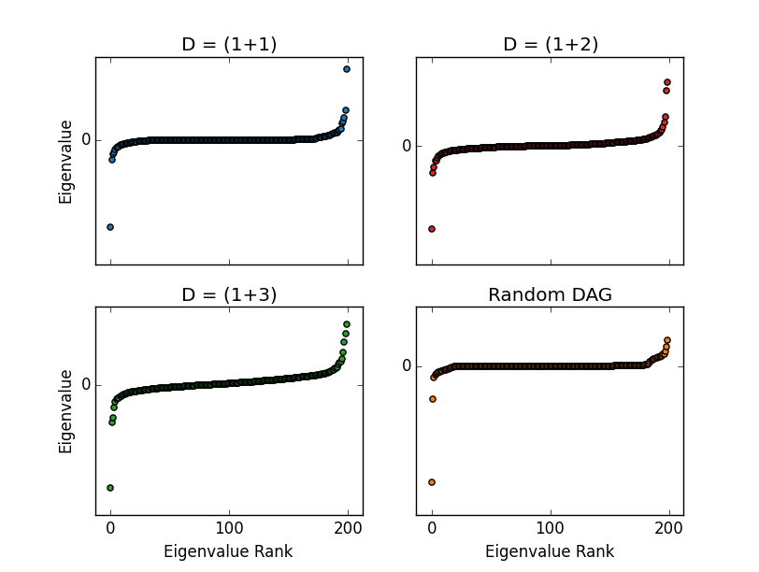
DAG Null Model Distance Matrix Eigenvalues
PPP in Minkowski Spacetime
2 space
1 space
time
time
no space
3 space
time
time
Eigenvalue Rank

Slide 27
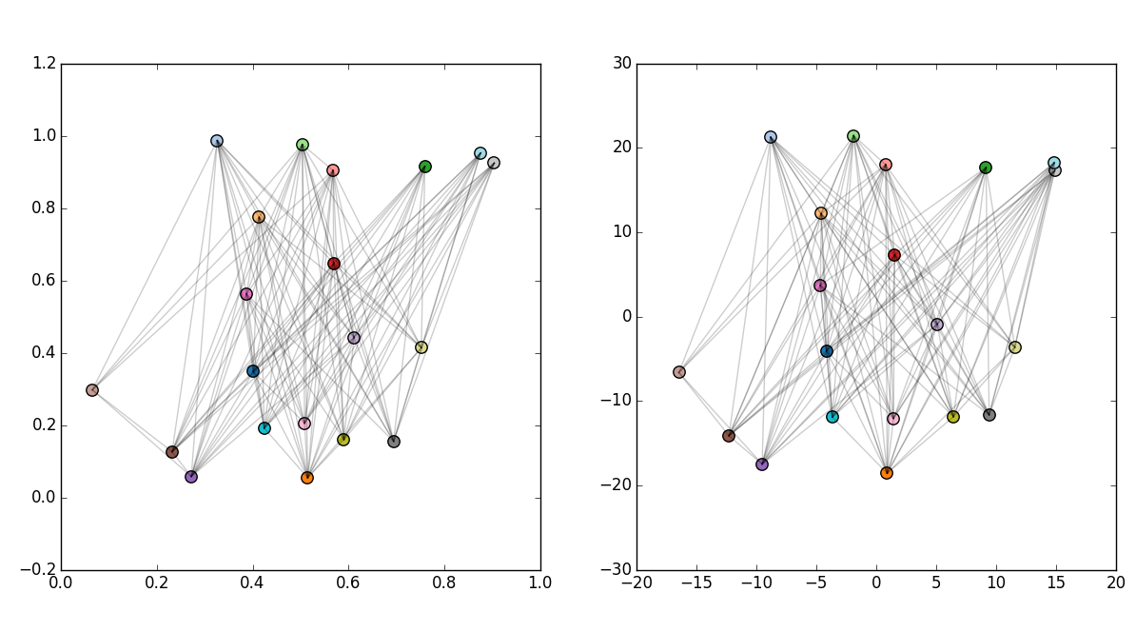
Lorentzian MDS works!
Subset 20 points of
200 shown for clarity
Original Causal Set
1+1 Embedding
LMDS coordinates for
1+1 dimensions

Slide 28
Real Citation Networks
Embed (ie. find coordinates) for papers in citation networks from
arXiv hep-th - 91% success
arXiv hep-ph - 88% success
These citation networks are more embeddable in Minkowski spacetime than you would otherwise expect
Notes:
Equivalent random graphs ~ 50%

Slide 29
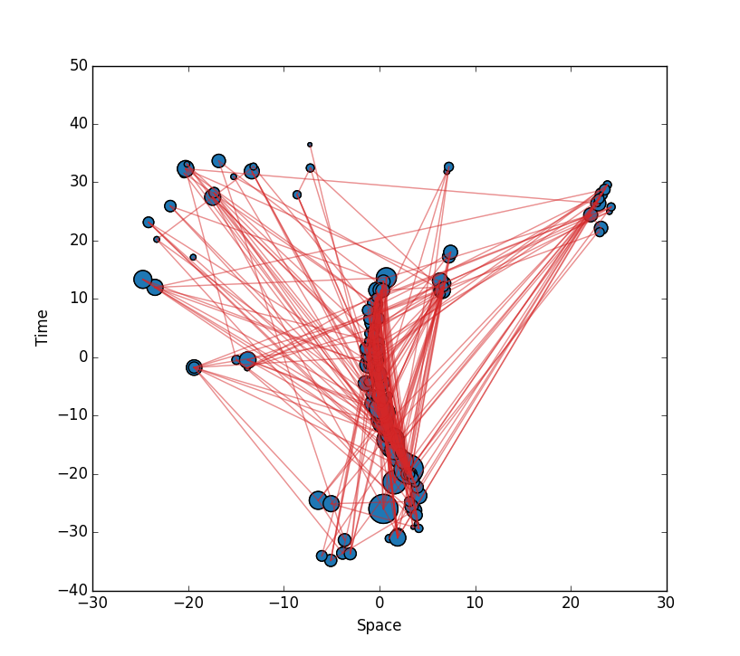
arXiv hep-th 1992-2003
arXiv:1602.03103
[Clough & Evans, 2016]
Based on top 200 most cited hep-th papers.
node size = citations

Slide 30
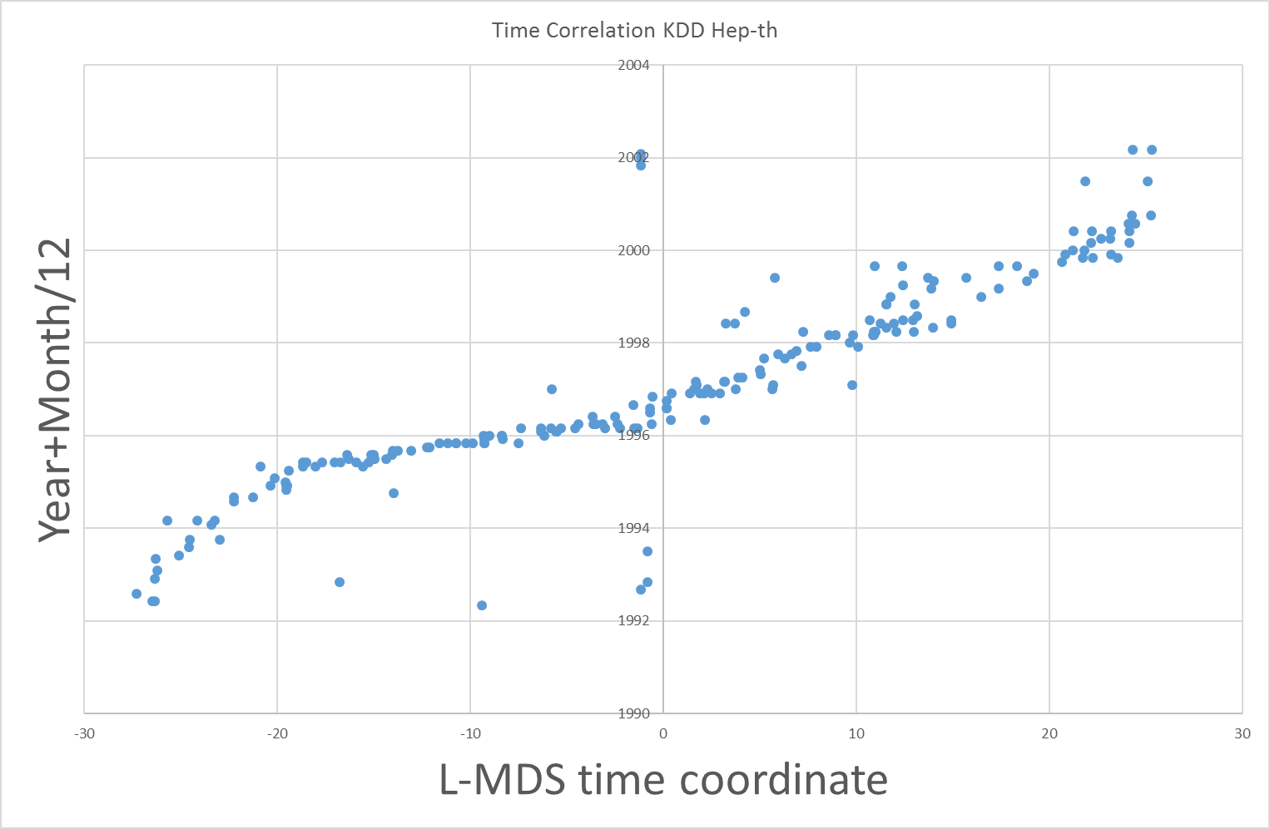
arXiv hep-th 1992-2003
2004
Publication Date
1990

Slide 31
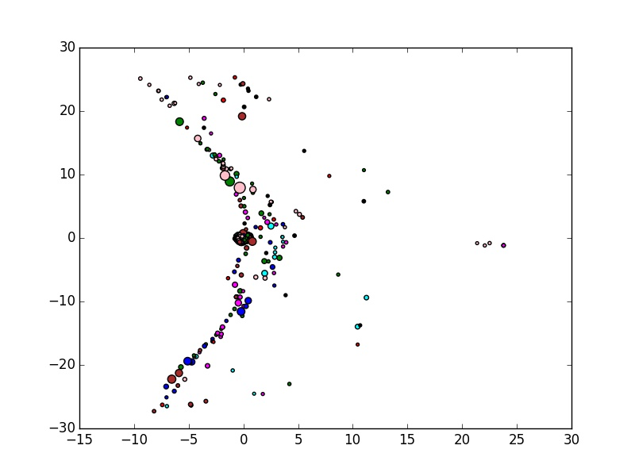
arXiv hep-th 1992-2003
Colours represent 8 k-means clusters based on abstract word similarity

Slide 32
Time & Networks
Causally Invariant Measures
  Transitive Reduction & Innovation
  Longest Path & Centrality
Netometry – Networks & Geometry
  Dimension
  Coordinate Assignment
Summary

Slide 33
Conclusions
Tim Evans, Imperial College London
http://netplexity.org
Temporal Networks come in two types
  time on vertices or time on edges
Constraints on networks require new tools in network analysis.
  Transitive Reduction, Dimension, Longest Path
  Geometry
Generalised MDS to Lorentzian Spacetime
  Reliable
  Might help to cluster papers
Work done with: James Clough,
Jamie Gollings, Tamar Loach, Sophia Goldberg, Hannah Anthony, Joana Teixeira, Chon Lei
Notes:
Based on erlier talk

Slide 34
Bibliography
Tim Evans
Centre for Complexity Science
http://netplexity.org
Albert, M. H. & Frieze, A. M., Random graph orders, Order, 1989, 6, 19-30.
Bombelli, L., Ph.D. thesis, Syracuse University, 1987.
Brightwell, G. & Gregory, R. Structure of random discrete spacetime, Phys. Rev. Lett., 1991, 66, 260-263
Bruggemann, R.; Halfon, E.; Welzl, G.; Voigt, K. & Steinberg, C. Applying the Concept of Partially Ordered Sets on the Ranking of Near-Shore Sediments by a Battery of Tests J. Chem. Inf. Model., American Chemical Society (ACS), 2001, 41, 918-925.
Bruggemann, R., M¨unzer, B. and Halfon, E., An algebraic/graphical tool to compare ecosystems with respect to their pollution – the German river “Elbe” as an example - I: Hasse-diagrams, Chemosphere, 28 (1994) 863–872.
Clough, J. R.; Gollings, J.; Loach, T.V. & Evans, T.S., Transitive reduction of citation networks, J.Complex Networks, 2015, 3, 189-203 [10.1093/comnet/cnu039 arXiv1310.8224]
Clough, J.R. & Evans, T.S. What is the dimension of citation space? Physica A 2016 448, 235-247 [10.1016/j.physa.2015.12.053 arXiv:1408.1274 ]
Clough, J.R. & Evans, T.S. Time and Citation Networks in "Proceedings of ISSI 2015 Istanbul: 15th International Society of Scientometrics and Informetrics Conference, Istanbul, Turkey, 29 June to 3 July, 2015", ISBN 978-975-518-381-7; ISSN 2175-1935 [arXiv:1507.01388]
Clough, J.R. & Evans, T.S. Embedding Graphs in Lorentzian Spacetime, arXiv:1602.03103
Evans, T.S., Complex Networks, Contemporary Physics, 2004, 45, 455-474 [10.1080/00107510412331283531 arXiv:cond-mat/0405123]
Evans, T.S., Clique Graphs and Overlapping Communities, J.Stat.Mech, 2010, P12037 [10.1088/1742-5468/2010/12/P12037 arXiv:1009.0638]
Evans, T.S. & Lambiotte, R., Line Graphs, Link Partitions and Overlapping Communities, Phys.Rev.E, 2009, 80, 016105 [10.1103/PhysRevE.80.016105 arXiv:0903.2181]
Evans, T.S. & Lambiotte, R., Line Graphs of Weighted Networks for Overlapping Communities, Eur.Phys.J. B 2010, 77, 265–272 [10.1140/epjb/e2010-00261-8 arXiv:0912.4389]
Expert, P.; Evans, T. S.; Blondel, V. D. & Lambiotte, R. Uncovering space-independent communities in spatial networks, PNAS, 2011, 108, 7663-7668 10.1073/pnas.1018962108 [10.1073/pnas.1018962108 arXiv:1012.3409]
Garfield, E.; Sher, I. H. & Torpie, R. J., The use of citation data in writing the history of science, DTIC Document, 1964.
Holme, P. & Saramäki, J., Temporal Networks, Physics Reports, 2012, 519, 97-125.
Hummon, N. P. & Dereian, P., Connectivity in a citation network: The development of DNA theory, Social Networks, 1989, 11, 39-63.
Masuda, N & Lambiotte, R, 2016. A Guide To Temporal Networks, World Scientific, ISBN 9781786341143.
Myrheim, J.. Statistical geometry, 1978. Technical report, CERN preprint TH-2538, 1978.
Meyer, D.A. The Dimension of Causal Sets. PhD thesis, MIT, 1988.
Meyer, D.A. Dimension of causal sets, 2006.
Reid, D. D. Manifold dimension of a causal set: Tests in conformally flat spacetimes, Phys. Rev. D 2003, 67, 024034.
Winkler, P., Random orders, Order, 1985, 1, 317-331

Slide 36
Time & Networks
Causally Invariant Measures
  Transitive Reduction & Innovation
  Longest Path & Centrality
Netometry – Networks & Geometry
  Dimension
  Coordinate Assignment
Summary

Slide 37
Transitive Reduction (Hasse Diagrams)
Remove all edges not needed for causal links
= Remove links provided all pairs
of connected points remain connected
= Remove links implied by transitivity
Uniquely defined because
of causal structure
Notes:
Network analysis looks at the whole structure of interconnections and so can help us see what was critical for the flow of information on the network, and what was not. People do not always know what was important so they can not tell us, they do not choose to cite a document just because it was critical to their work. Network analysis might help us see what was important from the actions of people in the context of the wider system.

Slide 38
Transitive Completion
Add all edges implied by causal links
= Add edge if there is a path between a pair of point
= Edge for any vertices with partial order
Uniquely defined because
of causal structure
Notes:
Network analysis looks at the whole structure of interconnections and so can help us see what was critical for the flow of information on the network, and what was not. People do not always know what was important so they can not tell us, they do not choose to cite a document just because it was critical to their work. Network analysis might help us see what was important from the actions of people in the context of the wider system.

Slide 39
Real DAG data
Edges represent some interaction e.g. citations
Not simply a causal relationship
Transitively
Reduced
Real
Network
Transitively
Complete
(Hasse
Diagram)
0.0
0.5
1.0

Slide 40
Two Types of Measurement
Causally Invariant Measures
Only see causal structure
Not sensitive to fraction of TR ↔ TC
e.g. Longest Path
Sensitive to TR ↔ TC completion Fraction
e.g. degree = citation counts

Slide 41
Time & Networks
Causally Invariant Measures
  Transitive Reduction & Innovation
  Longest Path & Centrality
Netometry – Networks & Geometry
  Dimension
  Coordinate Assignment
Summary

Slide 42
Dimension
y
Future
time
like
Assume an embedding of DAG
in Minkowskii space of
D dimensions
Information flows into forward light cone only
⇒ Find Dimension D
Space-
Like
x
Space-
Like
Past
time
like

Slide 43
Causal Set Model
Transitively
complete
y
Future
PPP in D-dimensional space
Take one dimension as time
Add edge from point x to and y if
and time-like separation
Space-
Like
x
Space-
Like
$$x_{0}<y_{0}$$
Past
$L^{2}=({x_{0}−y_{0})}^{2}−\sum_{i=1}^{d}{{{(x}_{i}{−y}_{i})}^{2}}$ > 0
Standard model used in
Discrete maths e.g. Bollobás & Brightwell 1991
Causal set quantum gravity e.g. see Dowker 2006

Slide 44
Longest Path and Causal Sets
Longest Path is the best approximation to the space-time geodesics in the Causal Set Models of Minkowskii space
[Brightwell & Gregory, 1991]
Also conjectured to be true of Causal Sets for general (curved) space-times

Slide 45
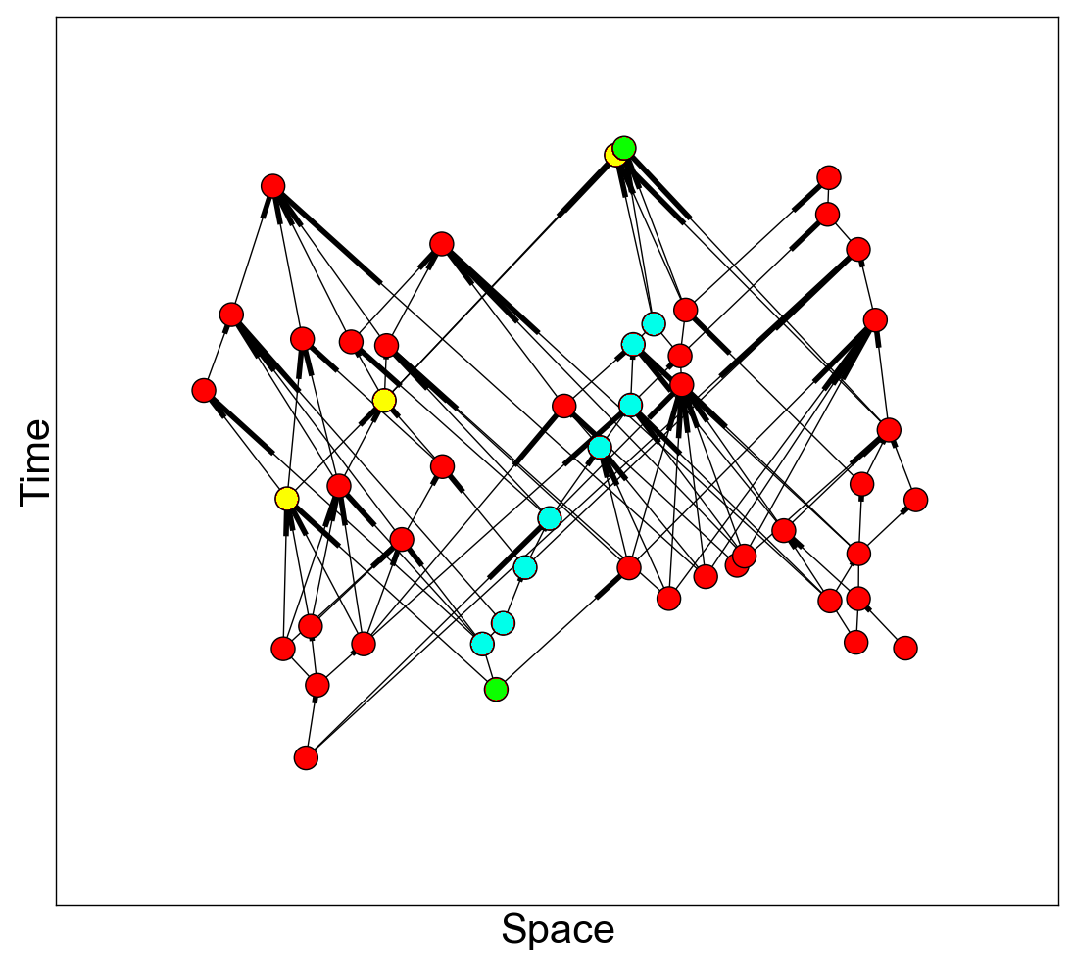
Longest Path in Causal Sets
Longest Path (9)
Geodesic
Shortest
Path (4)
Edges of Light
Cones
(Poisson Point Process in
1+1 dimension Minkowskii space)
Notes:
So how does shortest path scale with N?

Slide 46

Box Counting Direct
[Lei, Teixeira, Clough, Evans, 2016 unpublished]
sink
Choose an interval at random
  Interval = set of points on path from given
  source to specified sink nodes, sink/source
  chosen uniformly at random from vertex set
Measure Volume
= N number of points in interval (N>200 best)
Measure length of interval
= L longest path between source and sink
Repeat many times
Fit to to find D and m
source
$$L_{max}=m{ N}^{1/D}$$
Notes:
BSc Project Reports, 2016
(Jacky) Chon Lei & Joana Teixeira

Slide 47
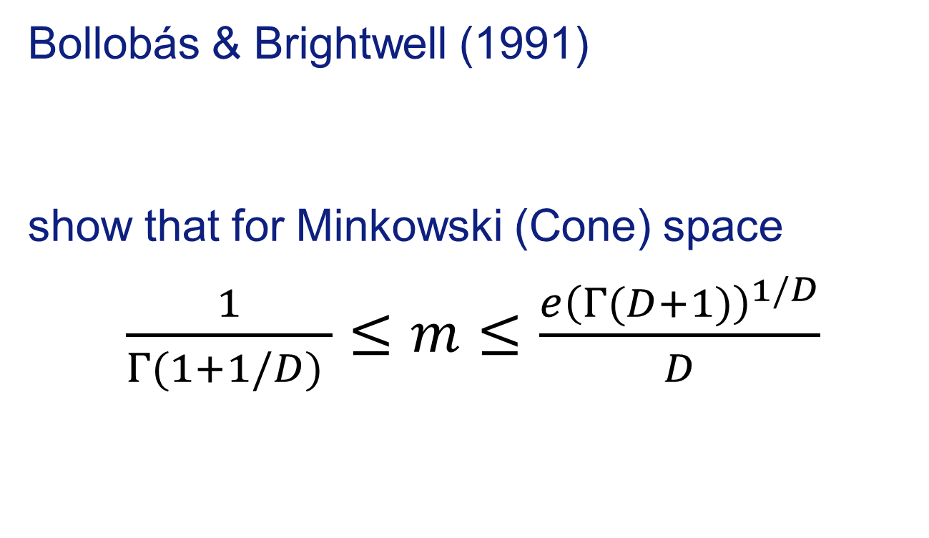
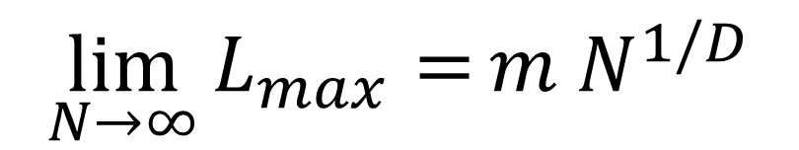
Longest Path L Scaling for Large N
Bollobás & Brightwell (1991)
show that for Minkowski (Cone) space
$\frac{1}{Γ(1+1/D) }≤m≤$ $\frac{e{\left(Γ(D+1)\right)}^{1/D}}{D}$
$$\lim_{N→∞}{L_{max}=}m{ N}^{1/D}$$
Greedy Path case
Finite Size
effects unknown?
Notes:
Bollobás, B. & Brightwell, G.
Box-Spaces and Random Partial Orders
Transactions of the American Mathematical Societ, 1991, 324, 59-72

Slide 48
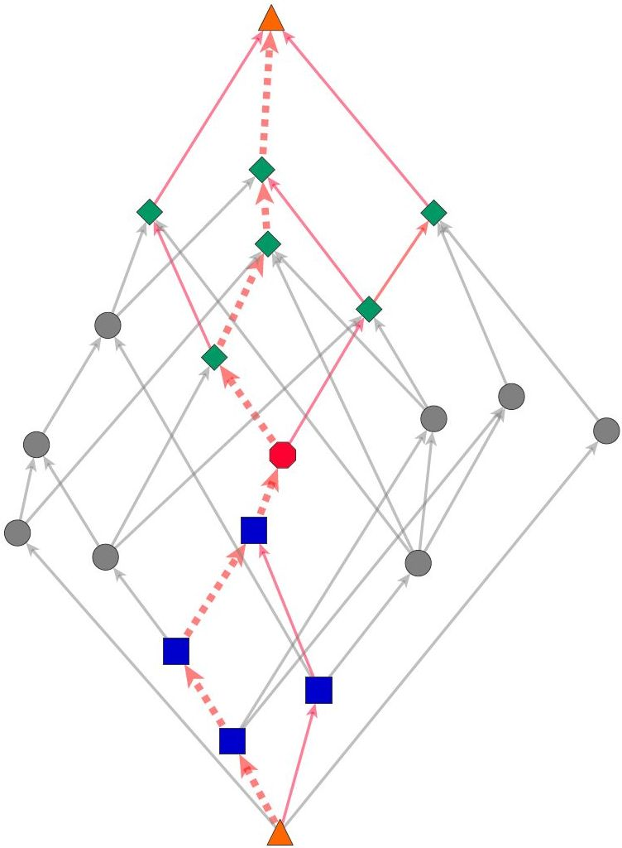
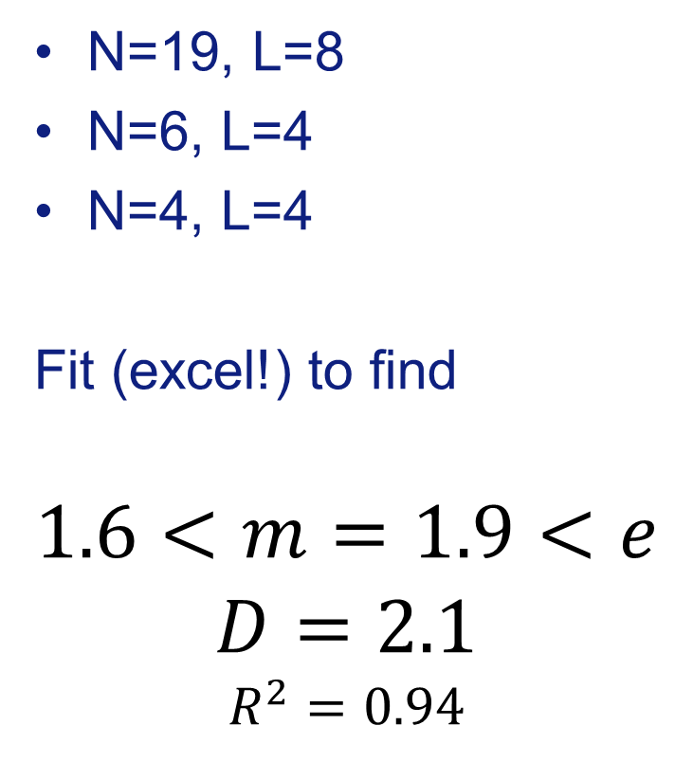
Silly Example
Causal Set in 1+1 Minkowski space,
PPP + connect timelike pairs
N=19, L=8
N=6, L=4
N=4, L=4
Fit (excel!) to find
$$1.6<m=1.9<e$$
$$D=2.1$$
$$R^{2}=0.94$$

Slide 49
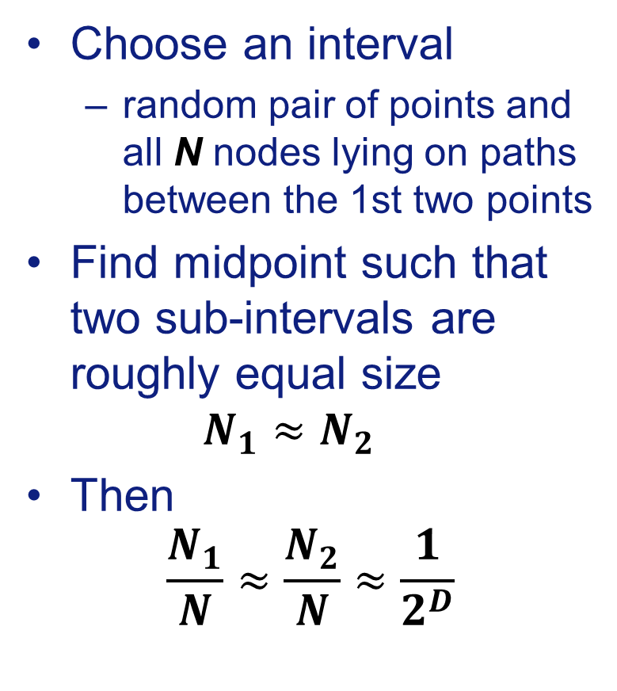
Midpoint Method (box counting)
[Bombelli 1988, Reid 2003]
Choose an interval
  random pair of points and all N nodes lying on paths between the 1st two points
Find midpoint such that two sub-intervals are roughly equal size
$N_{1}≈N_{2}$
Then
$$\frac{N_{1}}{N}≈\frac{N_{2}}{N}≈\frac{1}{2^{D}}$$
N₁=6
N=18
N₂=4
⇒ D = 1.61
2.16
Causal Set in
1+1 Minkowski space,
PPP + connect timelike pairs
Notes:
The N_1 interval was previously listed as having 5 elements not 6 but the old version was better – fix picture perhaps?

Slide 50
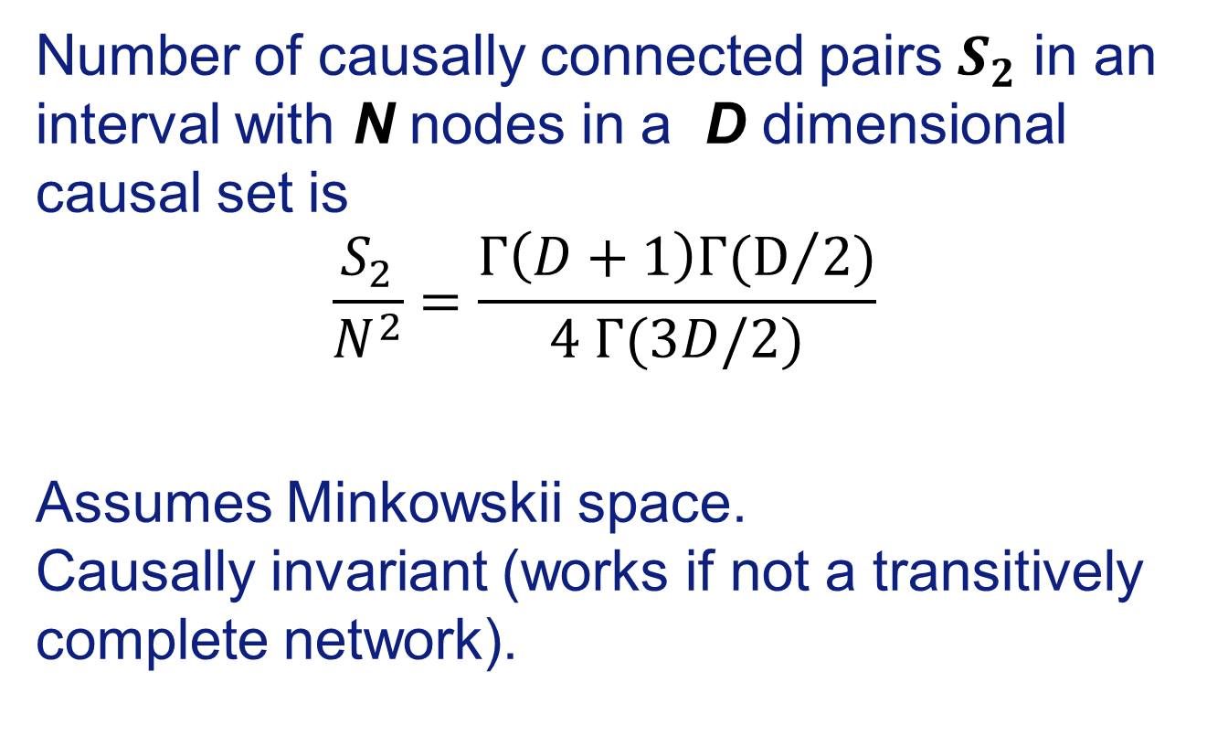
Myrheim-Meyer Dimension Estimator
[Myrheim 1978, Meyer 1988, Reid 2003]
Number of causally connected pairs $S_{2}$ in an interval with N nodes in a D dimensional causal set is
$$\frac{S_{2}}{N^{2}}=\frac{Γ\left(D+1\right)Γ(D/2)}{4 Γ(3D/2)}$$
Assumes Minkowskii space.
Causally invariant (works if not a transitively complete network).

Slide 51
Example of Myrheim-Meyer Method
N=4 internal points
S₂=4 causally connected pairs
⇒ D=2.0

Slide 52
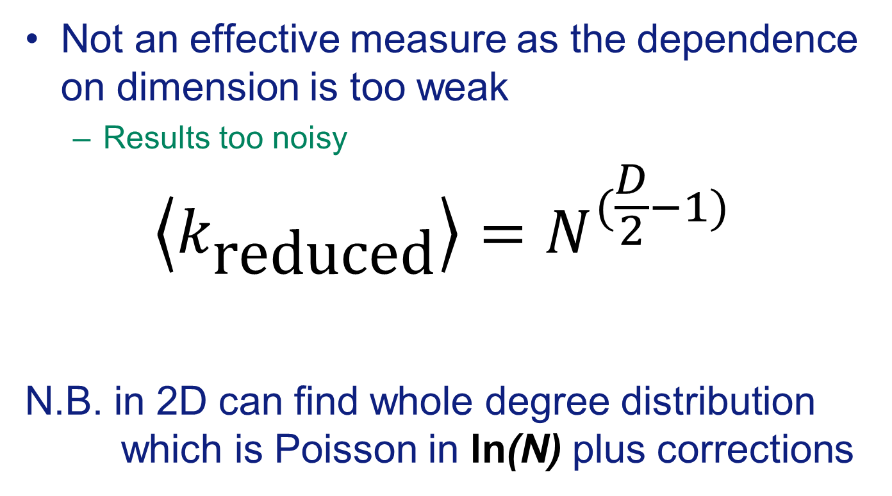
Degree after Transitive Reduction
Not an effective measure as the dependence on dimension is too weak
  Results too noisy
$$\left\langle k_{\text{reduced}}\right\rangle =N^{(\frac{D}{2}−1)}$$
N.B. in 2D can find whole degree distribution
which is Poisson in ln(N) plus corrections
[Bombelli et al 1987; Eichorn & Mizera 2014; Clough & TSE 2016]
[Clough & TSE 2016]
Notes:
L. Bombelli, J. Lee, D. Meyer, and R. Sorkin, “Space-time as a causal set”, Physical Review Letters, vol. 59, no. 5, pp. 521-524, 1987
A. Eichhorn and S. Mizera, “Spectral dimension in causal set quantum gravity”, Classical and Quantum Gravity, vol. 31, p. 125007, June 2014.

Slide 53
Dimension Measures for Social DAG
Results derived for Casual sets
= PPP in Minowkski space
Do they work for social DAG networks?

Slide 54
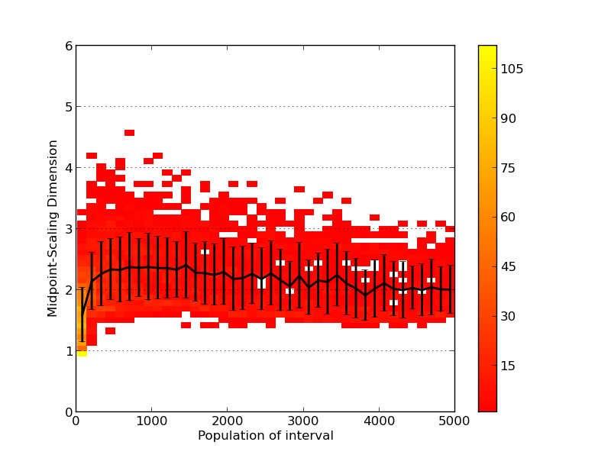
Comparison of Dimension Measures
[Clough & Evans 2016,
arXiv:1408.1274 ]
hep-th arXiv
# runs / 5000
MM Dimension
Midpoint Dimension
N
# nodes in interval
N
# nodes in interval
Notes:
The different methods are consistent

Slide 55
Comparison of Data Sources
[Clough & Evans 2016,
arXiv:1408.1274 ]
String Theory
hep-th arXiv
Particle Phenonemology
hep-ph arXiv
# runs
D=3
MM Dimension
MM Dimension
D=2
N
# nodes in interval
N
# nodes in interval
Notes:
The different methods are consistent

Slide 56
Dimensions
[Clough & Evans 2016,
arXiv:1408.1274 ]
Data | Dimension
hep-th (String Theory) | 2
hep-ph (Particle Physics) | 3
quant-ph (quantum physics) | 3
astro-ph (astrophysics) | 3.5
US Patents | >4
US Supreme Court Judgments | 3 (short times), 2 (long times)
String theory appears to be a narrow field
Notes:
Crudely, the `dimension' of the hep-th network appears to be around 2, and the
hep-ph network around 3, astro-ph around 3.5, and quant-ph also around 3.
Clough, J. & Evans, T.S. What is the dimension of citation space? 2014 arXiv:1408.1274

Slide 57
Time & Networks
Causally Invariant Measures
  Transitive Reduction & Innovation
  Longest Path & Centrality
Netometry – Networks & Geometry
  Dimension
  Coordinate Assignment
Summary

Slide 58
Transitive Reduction & Innovation
Conjecture:
Transitive Reduction removes unnecessary and indirect
influences on innovation trail
Links left after transitive
reduction are sufficient
for innovation
Remaining links are a
“lower bound” on the necessary links
Notes:
Network analysis looks at the whole structure of interconnections and so can help us see what was critical for the flow of information on the network, and what was not. People do not always know what was important so they can not tell us, they do not choose to cite a document just because it was critical to their work. Network analysis might help us see what was important from the actions of people in the context of the wider system.

Slide 59
Citation Counts
New Paper
Citations of academic papers sometimes
made for poor reasons:
Cite your own paper
Cite a standard paper
⇒ just copy citation from another paper?
(80%? [Simkin and Roychowdhury 2003;
Goldberg, Anthony, TSE 2015])
Recent
Paper
Standard
Paper
Transitive Reduction removes poor citations
  may also remove some useful ones …
Notes:
Simkin, M. & Roychowdhury, V.
Read before you cite!
Complex Systems, 2003, 14, 269-274
Goldberg, S.; Anthony, H. & Evans, T.S.
Modelling Citation Networks
Scientometrics, 2015, 105:, 1577-1604
[http://arxiv.org/abs/1408.2970 DOI: http://arxiv.org/abs/1408.2970]
Goldberg, S.; Anthony, H. & Evans, T.S.
Salah, A. A.; Tonta, Y.; Salah, A. A. A.; Sugimoto, C. & Al, U. (Eds.)
Do We Need Global and Local Knowledge of the Citation Network?
Proceedings of ISSI 2015 Istanbul: 15th International Society of Scientometrics and Informetrics Conference, Istanbul, Turkey, 29 June to 3 July, 2015, 2015, 282-283

Slide 60
Citation Counts
New Paper
Conjecture:
Transitive Reduction
removes poor citations
Assess papers with ``reduced degree’’
= degree after transitive reduction
- a causally invariant measure
Recent
Paper
Standard
Paper
Suggestion:
Reduced Degree < Paper Quality < Citation Count
Notes:
Simkin, M. & Roychowdhury, V.
Read before you cite!
Complex Systems, 2003, 14, 269-274

Slide 61
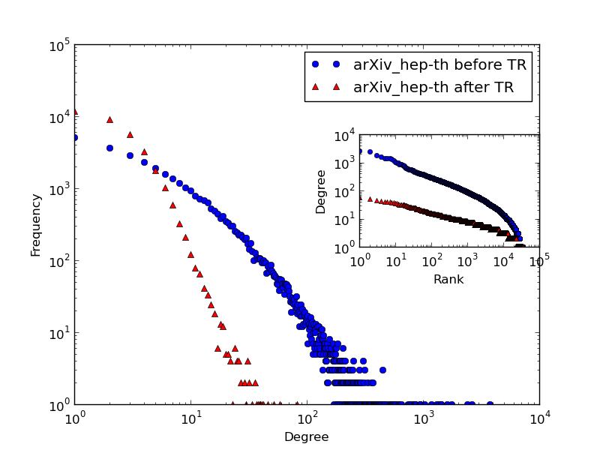
Degree Distribution before and after
Transitive Reduction – arXiv:hep-th
Lose 80%
of edges
hep-ph similar,
as Simkin &
Roychowdhury,
Goldberg et al.
Before TR
Frequency
After TR
Citation count
[Clough et al. 2015,
arXiv1310.8224]

Slide 62
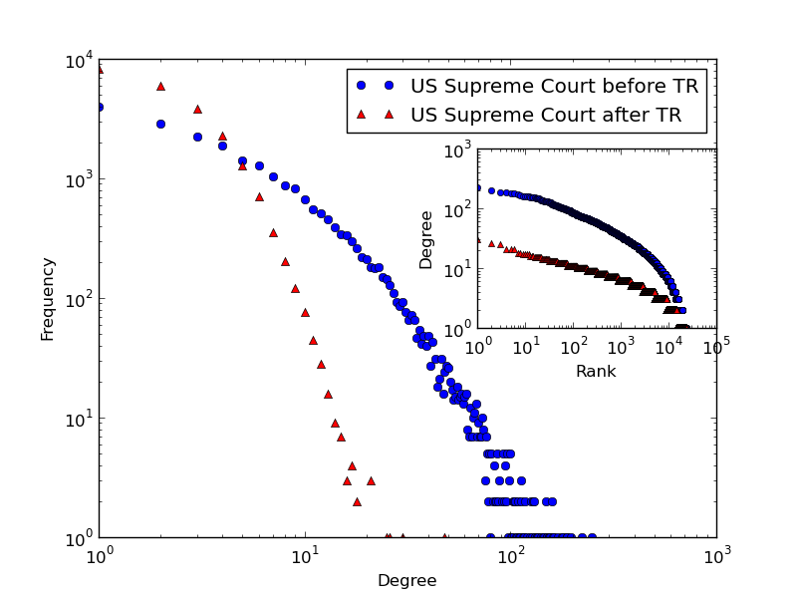
Degree Distribution before and after
Transitive Reduction – US Supreme Court
Lose 73%
of edges
Similar to
hep-th
Before TR
Frequency
After TR
# Citations
[Clough et al. 2015,
arXiv1310.8224]

Slide 63
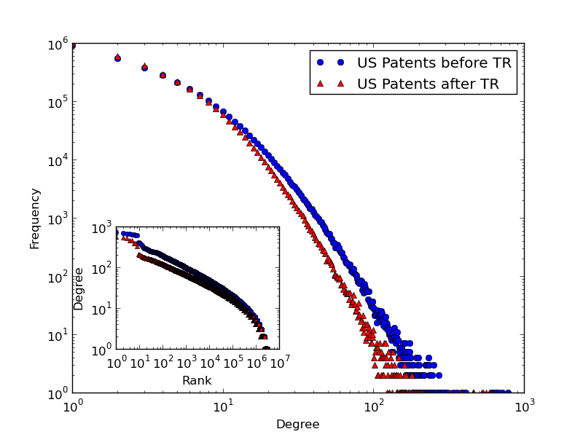
Degree Distribution before and after
Transitive Reduction – US Patents
Lose 15%
of edges
Very different to arXiv and court judgments
Before TR
Frequency
After TR
# Citations
[Clough et al. 2015,
arXiv1310.8224]

Slide 64
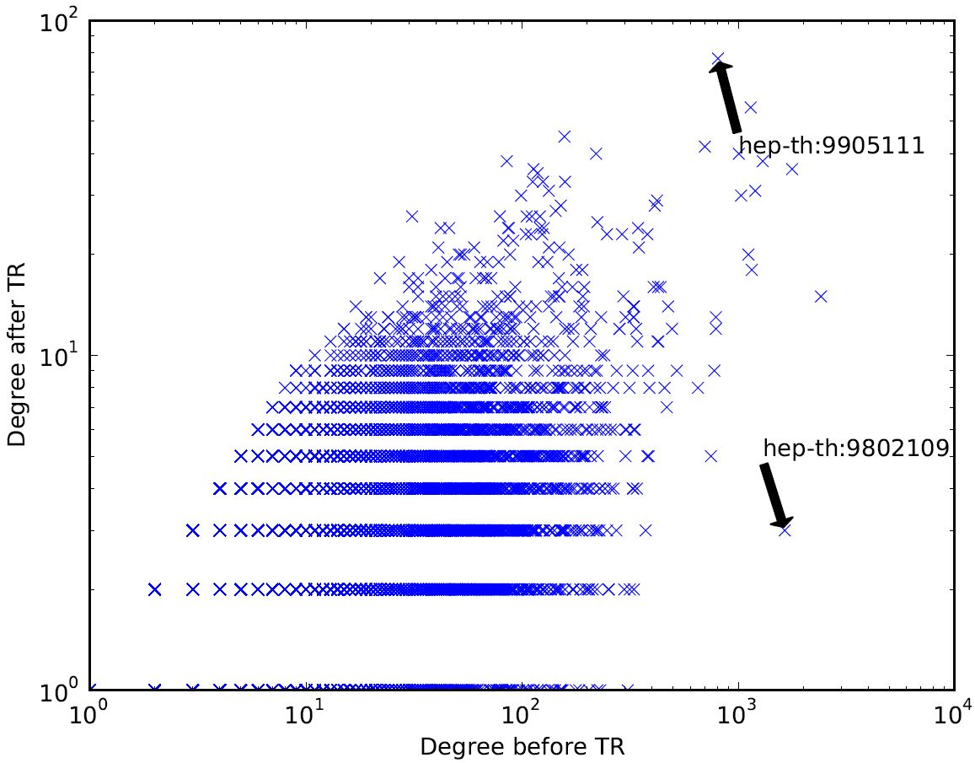
arXiv hep-th repository
Winner (806 → 77)
equal
Citation count after TR
Loser
(1641 → 3)
Citation count before TR
[Clough et al. 2015,
arXiv1310.8224]
Notes:
For instance, in the arXiv network, paper hep-th/9802109 (`Gauge Theory Correlators
from Non-Critical String Theory' by Gubsner et al.) was cited by 1641 papers in the
network, but only three citations remained after TR. This means that of those 1641
papers, three were special in that the other 1638 all also connected to this one via one
of those three papers. Anyone who took information from this hep-th/9802109 also took
information from one of hep-th/9802150, hep-th/9906004, or hep-th/9902130. This fact
is made explicit by transitive reduction.
On the other hand, paper hep-th/9905111 (`Large N Field Theories, String Theory
and Gravity' by Aharony et al.) begins with a similar number of citations, 806, yet after
TR it retains 77 of these. This means that there were 77 papers in this network which
cited hep-th/9905111 but who did not cite each other. It seems information taken from
this paper was utilised more diversely.
Are the winners after TR the papers with wider appeal, more cross-disciplinary applications?
Clough, J. R.; Gollings, J.; Loach, T. V. & Evans, T. S., Transitive reduction of citation networks, J.Complex networks to appear, 2014 [arXiv1310.8224]

Slide 65
Transitive Reduction and Citation Networks
Shows key differences between citation networks from different fields
  New test for models
Finds large differences in “reduced degree” between papers of similar citation counts
  ⇒ Alternative recommendation system
[Clough et al. 2015,
arXiv1310.8224]

Slide 66
Time & Networks
Causally Invariant Measures
  Transitive Reduction & Innovation
  Longest Path & Centrality
Netometry – Networks & Geometry
  Dimension
  Coordinate Assignment
Summary

Slide 67
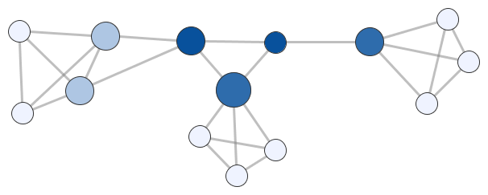
Path Length
The length of a path is the number of links on that path.
Path Length 6
Notes:
Degree = width and height, betweenness = colour
networkcentralityexample.graphmlz
networkcentralityexampleSizeDeg-ColourBness.*

Slide 68
Distance Between Vertices
The distance between vertices may be set equal to the length of the shortest path.
Distance between
vertices = 4
Notes:
Degree = width and height, betweenness = colour
networkcentralityexample.graphmlz
networkcentralityexampleSizeDeg-ColourBness.*

Slide 69
Longest Path
Longest paths have no meaning for most networks as such paths typically visit a large fraction of network
Longest Path
Length 9

Slide 70
Time and Longest Path
Longest paths are well defined when a time is defined
- you never go backwards
Longest Path Length 5
TIME

Slide 71
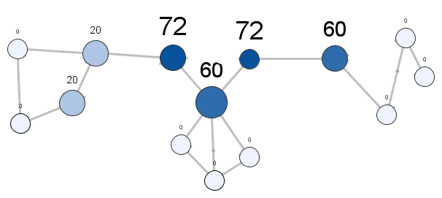
Longest Path and DAG
Longest Paths are unchanged by transitive reduction
They only use links which are essential for the causal structure
Causally Invariant
TIME

Slide 72
Time & Networks
Causally Invariant Measures
  Transitive Reduction & Innovation
  Longest Path & Centrality
Netometry – Networks & Geometry
  Dimension
  Coordinate Assignment
Summary

Slide 73
Centrality
Network centrality measures try to describe the importance of a network.
e.g. degree, (shortest path) betweenness, …
Size ∝ Degree
Darker = Higher Betweenness
Notes:
Degree = width and height, betweenness = colour
networkcentralityexample.graphmlz
networkcentralityexampleSizeDeg-ColourBness.*

Slide 74
Centrality Measures for DAGs
Seems that we should use longest path not shortest path for DAGs

Slide 75
Small Example: DNA Citation Network
40 key events (mostly single papers) in the development of the theory of DNA
  Links are both direct citations and citations via an intermediary paper with a common author.
[Asimov 1962; Garfield, Sher, Torpie,1964;
Hummon & Dereian 1989]
Notes:
Garfield, E.; Sher, I. H. & Torpie, R. J.
The use of citation data in writing the history of science
DTIC Document, 1964
Review: Origin of the data on the DNA papers historiography.
Hummon, N. P. & Dereian, P.
Connectivity in a citation network: The development of DNA theory
Social Networks, Elsevier, 1989, 11, 39-63
Review: This paper applies network analysis to the DNA network. Includes main path analysis. Also has some nice summaries of the nodes.
20 - Avery et al 1944
21 - Chargaff 1947 - base pairs
22 - Chargaff 1950 - relative number of base pairs differs by species
27 - Watson and Crick 1953 - double helix - Nobel in 1962
32 - Ochoa 1955 - Nobel in 1959

Slide 76
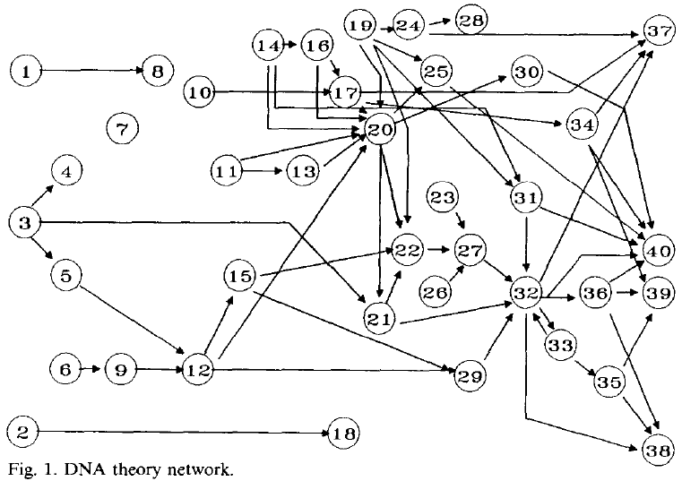
DNA Citation Network
[Fig 1, Hummon & Dereian 1989]
Nobel
Watson &
Crick ‘53
27
Ochoa ‘55
32
Miescher
1871
TIME
Notes:
20 - Avery et al 1944
21 - Chargaff 1947 - base pairs
22 - Chargaff 1950 - relative number of base pairs differs by species
27 - Watson and Crick 1953 - double helix - Nobel in 1962
32 - Ochoa 1955 - Nobel in 1959

Slide 77
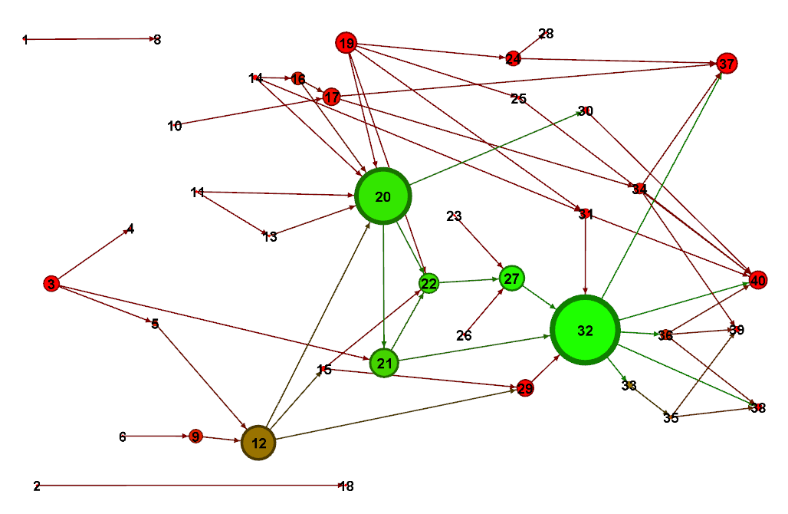
Shortest Path Betweenness for DNA Network
Size = Shortest Path Betweenness
Colour = Longest Path Betweenness
Notes:
20 - Avery et al 1944
21 - Chargaff 1947 - base pairs
22 - Chargaff 1950 - relative number of base pairs differs by species
27 - Watson and Crick 1953 - double helix - Nobel in 1962
32 - Ochoa 1955 - Nobel in 1959

Slide 78
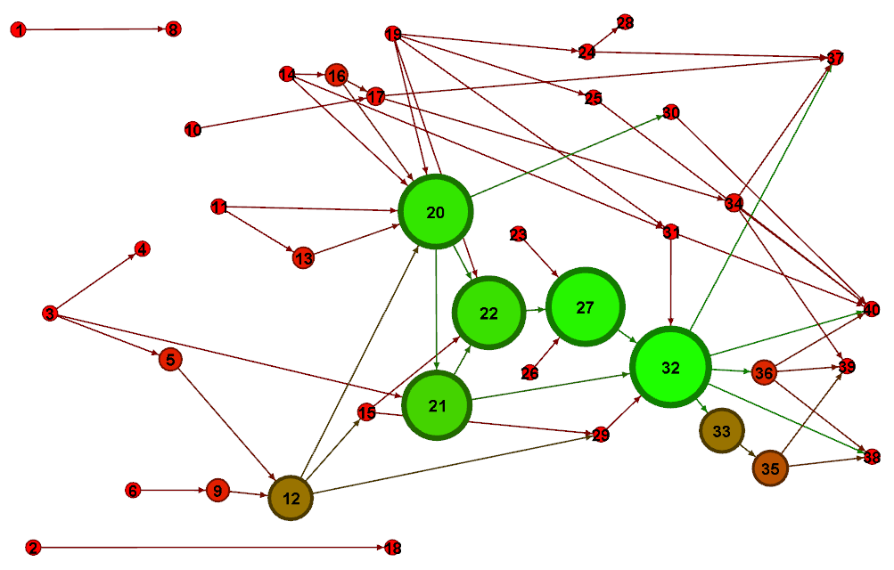
Longest Path Betweenness for DNA Network
Size = Longest Path Betweenness
Colour = ditto
Notes:
JC (8/6/15 email):- So the colours are just the same as the sizes of the nodes with red=small=low_betweenness up to green=big=high_betweenness - its done by gephi and I think its a bit non-linear ie. things of different sizes can seem to have very similar colours but should be monotonic if that makes sense. I guess the brown ones are in the middle.
I think I sent you a couple of weeks ago the .gephi file so you should be able to open it from that. The positions I did by hand to try and get them to match the diagram in the Doreain paper where it originally came from but they are not necessarily 100% accurate.

Slide 79
Centrality for DAGs
Longest Path Centrality shows promise
Experimenting with other approaches
Comparing with “main path analysis” of bibliometrics field [Hummon & Dereian 1989]

Slide 80
Rankings & Cube Space

Slide 81
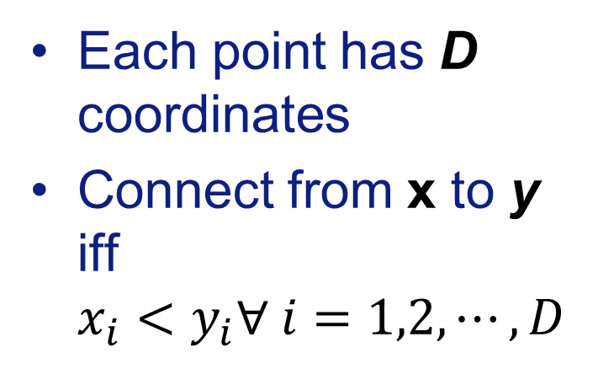
Cube Box Space
D=2
Each point has D coordinates
Connect from x to y
iff
$x_{i}<y_{i}∀ i=1,2,⋯,D$
[Bollobás & Brightwell 1991]

Slide 82
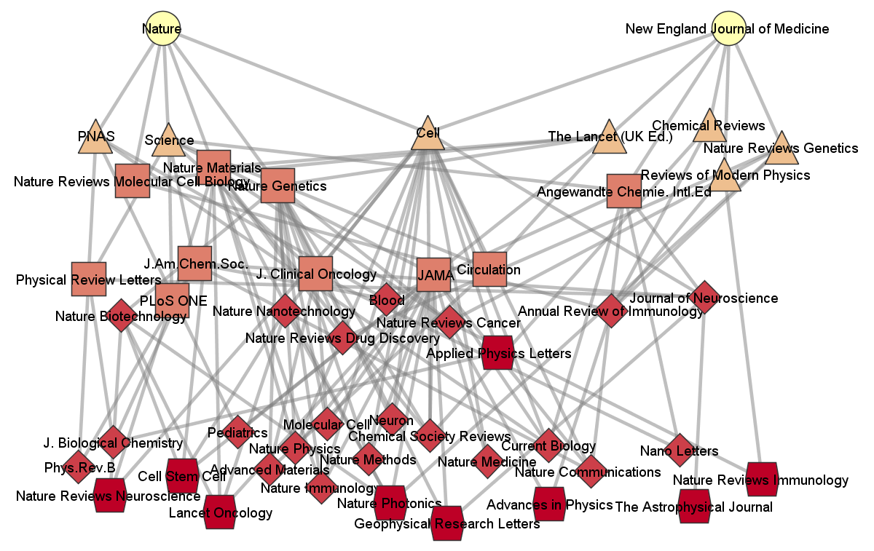
Box Space Representation of Journal Rankings
Node = Journal
Directed Edge
if journal has
better IF, EF
& CA
Height
=
minimum
longest
path
distance
to root
Top 1000
journals
used
Top 40 shown
worse
Hasse diagram technique
[Brüggeman et al. 1994]
Notes:
C:\Users\time\OneDrive\Documents\RESEARCH\DAG\Ratings\ifefca_r1000_level49edit.*
Produced by data_journals_tim.py in Dag suite of code.
Figure 2 DAG of top forty nine academic journal based on level where nodes with a similar vertical position have the same level. The colour and shape reflects the height, a similar measure to level. Nodes of the same colour or at roughly the same vertical position are placed in the same group. The higher the group the more highly rated the journal. Based on Impact Factor (2013), Eigenfactor (2013) and Combined altmetrics.com rating of the DAG formed from the top 1000 journals by ASR (average score rating).
Bru¨ggemann, R. In Proceedings of the Workshop on Order Theoretical
Tools in EnVironmental Sciences; Berichte des IGB, Institut fu¨r
Gewa¨ssero¨kologie und Binnenfischerei: Berlin, 1998; Heft 6, Sonderheft
I, pp 1-9.
(3) Bru¨ggemann, R.; Halfon, E. Comparative Analysis of Nearshore
Contaminated Sites in Lake Ontario: Ranking for Environmental
Hazard. J. EnViron. Sci. Health 1997, A32(1), 277-292.
(4) Bru¨ggemann, R.; Oberemm, A.; Steinberg, C. Ranking of Aquatic
Effect Tests Using Hasse Diagrams. Toxicol. EnViron. Chem. 1997,
63, 125-139.
(5) Bru¨ggemann, R.; Bartel, H.-G. A Theoretical Concept to Rank
Environmentally Significant Chemicals. J. Chem. Inf. Comput. Sci
1999, 39, 211-217.
Bruggemann, R., Schwaiger, J. and Negele, R.D., Applying Hasse diagram technique for the evaluation of toxicological fish tests, Chemosphere, 30 (1995) 1767–1780.
Bruggemann, R., M¨unzer, B. and Halfon, E., An algebraic/graphical tool to compare ecosystems with respect to their pollution – the German river “Elbe” as an example - I: Hasse-diagrams, Chemosphere, 28 (1994) 863–872.

Slide 83
DAG Models

Slide 84
DAG Models
Causal Set Models
PPP in space with at least one time direction
  Minkowski (Cone) space
  Cube Space (useful for multiple rankings)
  [e.g. Bollobas & Brightwell 1991, Clough et al 2015, Clough & TSE 2016]
Growing Network Models - Growth = Time
  [e.g. Price 1965, Barabasi-Albert 1999, Chung-Lu 2000, …]
  More realistic citation models, see Goldberg, Anthony, TSE 2015 and refs therein
Any Network Model + Vertex Order
  Random Partial Orders
  e.g. Winkler 1985, Albert & Frieze 1989
Notes:
Albert, M. H. & Frieze, A. M.
Random graph orders
Order, Springer, 1989, 6, 19-30
Winkler, P.
Random orders
Order, Springer, 1985, 1, 317-331
William Aiello, Fan Chung, and Linyuan Lu, “A random graph model for massive graphs”, in STOC’00. 2000, pp. 171–180, ACM.
W. Aiello, F. Chung, and L. Lu, “A random graph model for power law graphs,” Experimental Mathematics, vol. 10, pp. 53–66, 2001.
F. Chung and L. Lu, “The average distances in random graphs with given expected degrees,” Proceedings of the National Academy of Sciences USA, vol. 99, pp. 15 879–15 882, 2002.
F. Chung and L. Lu, “Connected components in random graphs with given degree sequences,” Annals of Combinatorics, vol. 6, pp. 125–145, 2002

Slide 85
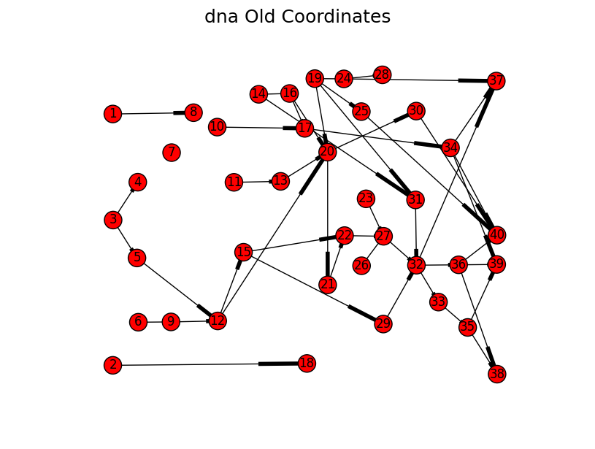
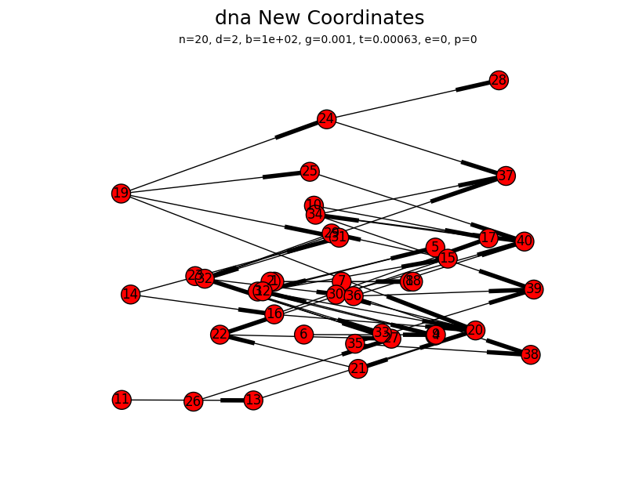
Spatial Coordinates
Similarities to network layout problems
However our work shows data needs D>2
We exploit the space-time structure for speed

Slide 86
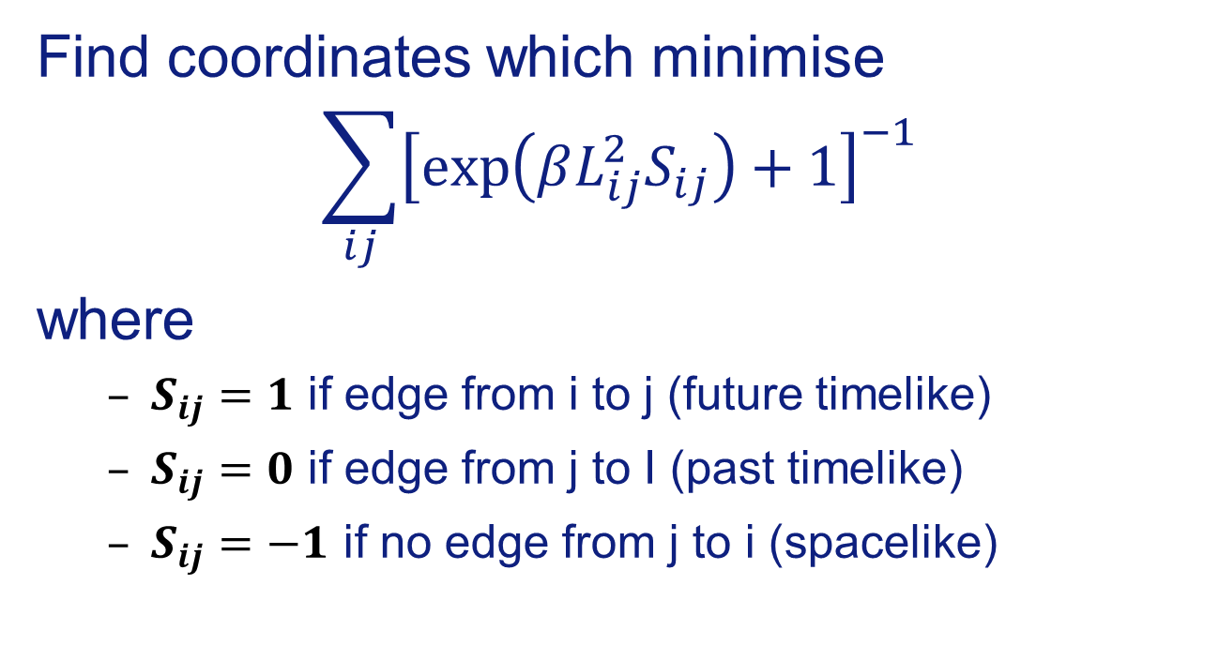
Optimisation Approach
Find coordinates which minimise
$$\sum_{ij}{{\left[\exp\left(βL_{ij}^{2}S_{ij}\right)+1\right]}^{−1}}$$
where
  $S_{ij}=1$ if edge from i to j (future timelike)
  $S_{ij}=0$ if edge from j to I (past timelike)
  $S_{ij}=−1$ if no edge from j to i (spacelike)

Slide 87
Time & Networks
Transitive Reduction
Dimension
Summary
Longest Path
Geometry
Further Material

Slide 88
Basics Statistics Before and After Transitive Reduction
Network | hep-th |  | US patents |  | US Supreme Court
before/after TR | before | after | before | after | before | after
# nodes | 27383 | 27383 | 3764094 | 3764094 | 25376 | 25376
# edges | 351237 | 62257 | 16510997 | 13996169 | 216198 | 59032
Clustering | 0.249 | 0 | 0.0757 | 0 | 0.163 | 0
Mean in-degree | 12.82 | 2.27 | 4.39 | 3.71 | 8.52 | 2.33
Median in-degree | 4 | 2 | 2 | 2 | 5 | 2
1st Q in-degree | 1 | 1 | 0 | 0 | 0 | 0
3rd Q in-degree | 12 | 3 | 6 | 6 | 11 | 3
Gini coef | 0.729 | 0.481 | 0.684 | 0.67 | 0.62 | 0.51

Slide 89
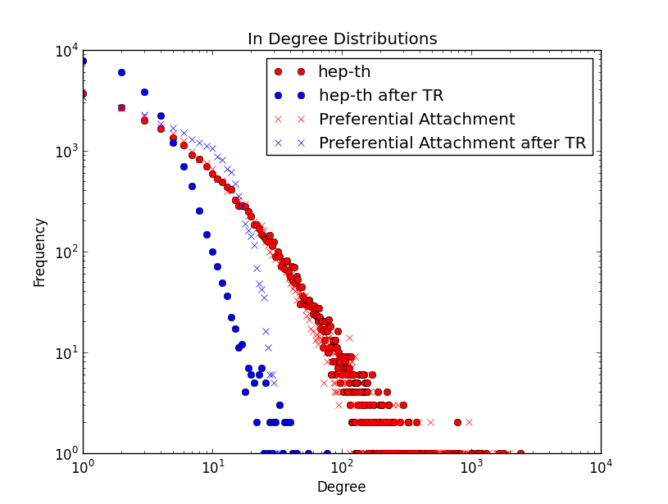
Degree Distribution, Null Models and TR

Slide 90
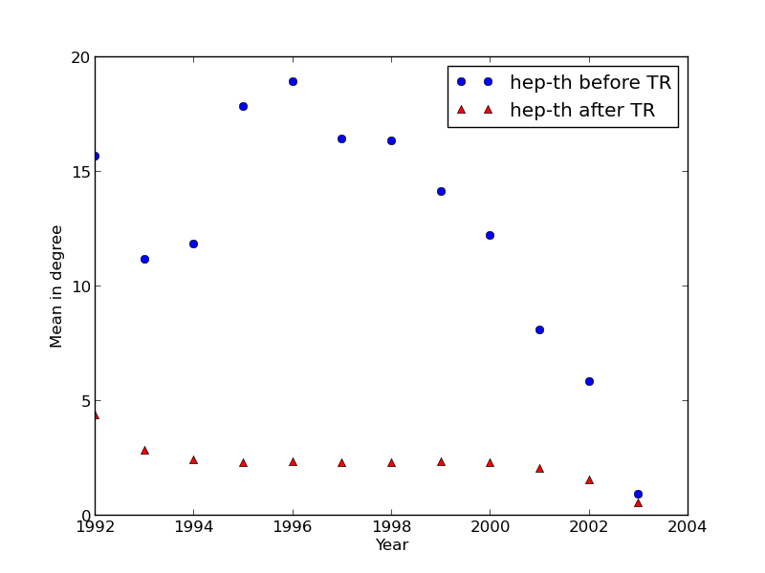
Degree by year of Publication – hep-th

Slide 91
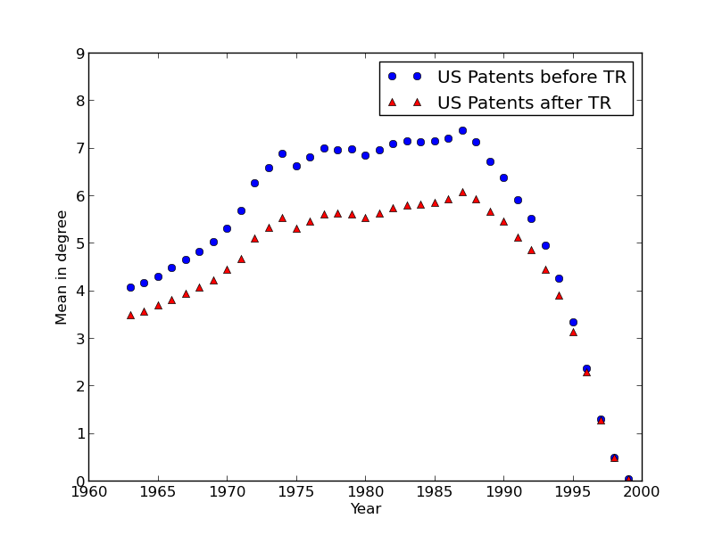
Degree by year of Publication – US Patents

Slide 92
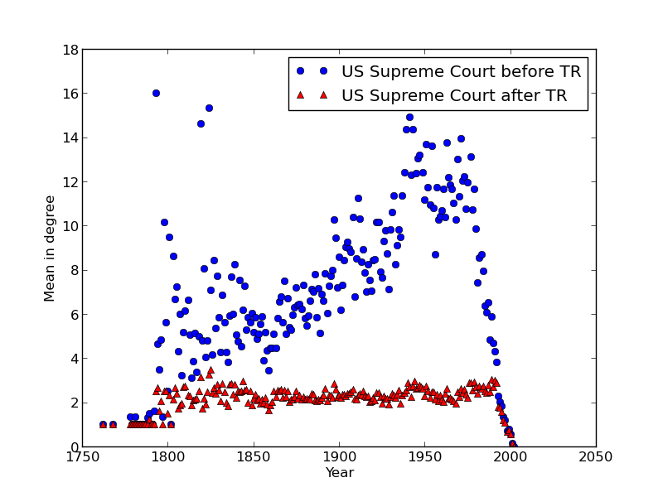
Degree by year of Publication – US Supreme Court

Slide 93
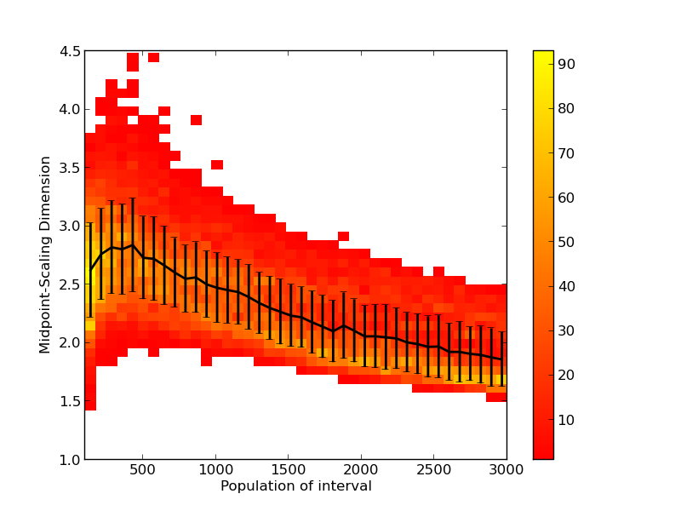
Midpoint Dimension for US Supreme Court
M.-M.
dimension
similar,
larger
errors

Slide 94
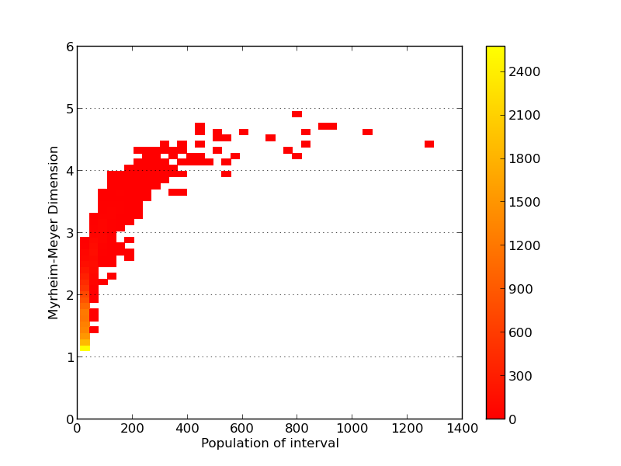
US Patents, Myrheim-Meyer Dimension
Midpoint
similar
but
slightly
worse

Slide 95
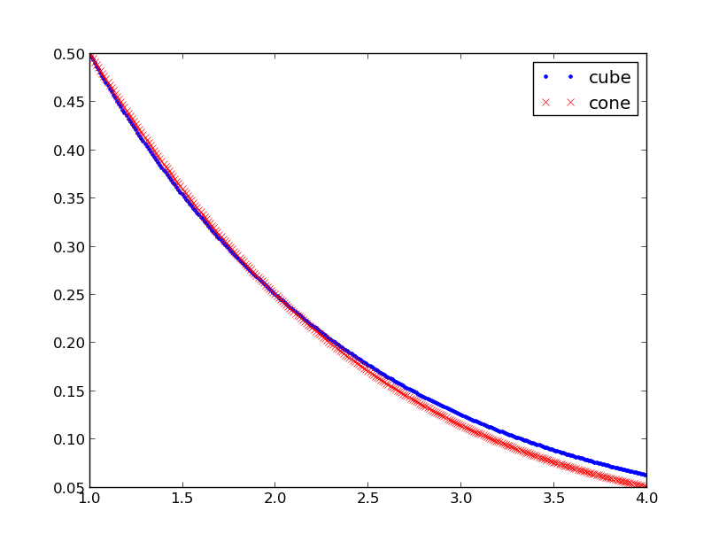
Cone vs Cube Space Models
Identical
at D=2 as
expected
Cube space
gives larger
dimension
estimates for
D>2,
about 7%
bigger if D~3
# 2-Chains S₂
Dimension D

Slide 96
Time & Networks
Transitive Reduction
Dimension
Longest Path
Finding Coordinates
Geometry
Summary

Slide 97
Finding Coordinates

Slide 98
Old Material

Slide 99
Timed Vertices + Edges
Temporal Edge
Networks
e.g. Communication Networks
– Email, phone, letters
as in rev Holme & Saramäki,
Temporal Networks 2012

Slide 100
Timed Edges = Temporal Edge Networks
Communication Networks
Email
Phone
Letters
Focus of much recent work
[Holme & Saramäki 2012]
Notes:
as in review by Holme & Saramäki, Temporal Networks 2012

Slide 101
Vertices + Timed Edges
Temporal Vertex
Networks
Each vertex represents an event happening on one time
⇒ Innovations
Patents
Research Papers
Court Judgments
⇒ Citation Networks

Slide 102
Timed Vertices = Temporal Vertex Networks
Each vertex represents an event occurring at one time
⇒Time constrains flows
Edges point in one
direction only
No Loops
time

Slide 103
Key Properties of Temporal Vertex Networks
Directed
  e.g. citation from newer to older paper
  or reverse if prefer
Acyclic
  can not cite a newer paper
Directed Acyclic Graph = DAG
time

Slide 104
Key Properties of Temporal Vertex Networks
Edges of a DAG define a
partial order of the set of vertices
- a poset
There are many ways order to vertices
(total or linear orders)
A
A
B
B
C
C
D
D
E
E
Notes:
Link here to discrete mathematics

Slide 105
DAGS and Flows
DAGs represent many different types of Flows
e.g. B,C ⇒ A
Flow of Ideas – Innovations, Citation Networks
  papers, patents, court judgements
Flow of Projects
  Management of Tasks, Critical paths
Flow of Mathematical Logic
  Spreadsheet formulae
A
B
C
D
E

Slide 106
Innovations
Each vertex represents a discovery
Patent
Academic Paper
Law Judgment
Information is now copied from
one node to all connected events
in the future
Different process from a random walk
Similar to epidemics but different network

Slide 107
Applications
Flow of Ideas:
Innovations, Citation Networks
  papers, patents, court judgements
Flow of Projects
  management of tasks, critical paths
Flow of Mathematical Logic
  spreadsheet formulae
Flow of Space-Time Causality
  Causal Set approach to quantum gravity
Spread like epidemics but very different network

Slide 108
Timed Vertices = Temporal Vertex Networks
Each vertex represents one event occurring at one time
⇒Time constrains flows
Directed edges point in
one direction only
No loops
Directed Acyclic Graph (DAG)
Poset (partially ordered set)
→ Discrete Mathematics

Slide 109
Applications
Flow of Ideas & Innovations:
Citation Networks
  papers, patents, court judgements
Flow of Projects
  management of tasks, critical paths
Flow of Mathematical Logic
  spreadsheet formulae
Flow of Space-Time Causality
  Causal Set approach to quantum gravity

Slide 110
Temporal Edge/Vertex Network Relationship
Types related by
Line Graph transformation

Slide 111
Temporal Vertex -> Edge Network
Directed Line Graph transformation
A
7
6
7
6
B
4
C
5
5
4
D
3
2
1
3
1
2
E

Slide 112
Temporal Edge -> Vertex Network
(Directed) Line Graph transformation
Person
Person
E
4
D
4
Email
Chain
D
3
C
3
C
2
2
C
D
B
1
1
B
1
1
Time of email
A
Email

Slide 113
Temporal Spread vs. Temporal Events
Spreading on a geographical network is very different from temporal events network
A
2
A
y
B
1
B
C
1
DAG
C
D
1
D
E
0
x
E
Arrival time is shortest path
distance from source

Slide 114
Temporal Spread vs. Temporal Events
Same geographical network,
different source vertex
A
1
A
y
B
2
B
C
0
DAG
C
D
1
D
E
1
E
x
Arrival time is shortest path
distance from source

Slide 115
Temporal Spread vs. Temporal Events
Same network, same process,
different source vertex ⇒ different DAG
A
A
B
B
A
B
D
C
C
D
D
or
E
C
E
E
DAG, source E
DAG, source C

Slide 116
Temporal Edge/Vertex Network Relationship
Types related by
Line Graph transformation
[c.f. Evans and Lambiotte, 2009, 2010;
Ahn et al. 2010]

Slide 117
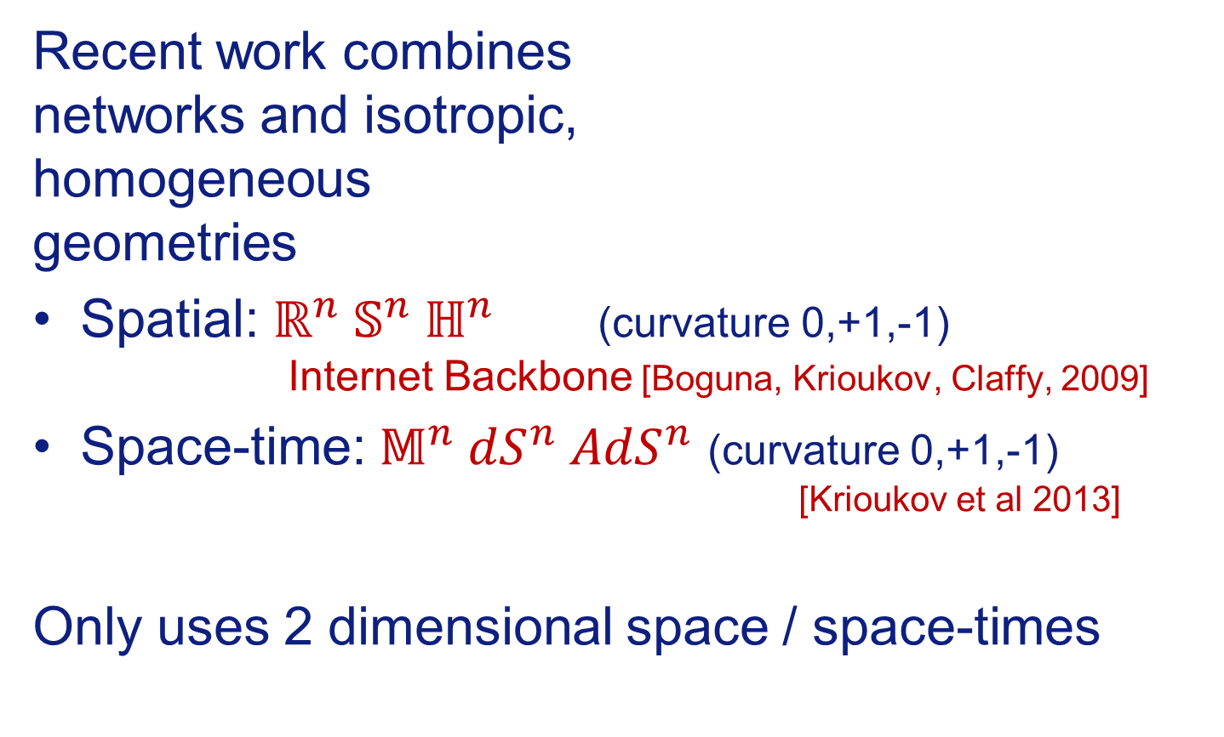
Networks and Geometry
Recent work combines
networks and isotropic,
homogeneous
geometries
Spatial: $ℝ^{n} 𝕊^{n} ℍ^{n}$ (curvature 0,+1,-1)
Internet Backbone [Boguna, Krioukov, Claffy, 2009]
Space-time: $𝕄^{n} {dS}^{n} {AdS}^{n}$ (curvature 0,+1,-1)
[Krioukov et al 2013]
Only uses 2 dimensional space / space-times
Notes:
Krioukov, D.; Kitsak, M.; Sinkovits, R. S.; Rideout, D.; Meyer, D. & Boguna, M.
Network Cosmology
Nature Scientific Reports, 2012, 2, 793
Boguna, M.; Krioukov, D. & Claffy, K. C.
Navigability of complex networks
Nat Phys,, 2009, 5, 74-80

Slide 118
Questions for “Netometry”
= Networks + Geometry
Dimension of space?
  Only 1 spatial dimension used in curved space work but we normally find more than 1 space dimension
Assigning spatial coordinates
  Define similarity/difference between topics
Do we need Curvature?
  How do you measure it?
  Locally flat so perhaps find post-hoc
Non-metric spaces
  Cube Box spaces [Bollobás & Brightwell 1991]

Slide 119
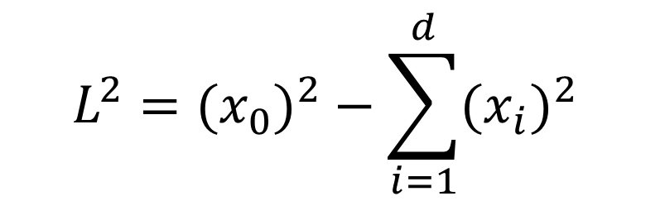
Minkowskii Space
My approach is to use simplest space-time
Minkowski space
in D = (d+1) space-time dimensions
$$L^{2}={{(x}_{0})}^{2}−\sum_{i=1}^{d}{{{(x}_{i})}^{2}}$$
[Clough & Evans, Physica A 2016 (to appear) arXiv:1408.1274;
ISSI Proceedings, arXiv1507.01388; also in preparation]
Notes:
Clough, J. & Evans, T.
What is the dimension of citation space?
Physica A 2016 (to appear) [http://arxiv.org/abs/1408.1274]
Clough, J. & Evans, T.S.
Salah, A. A.; Tonta, Y.; Salah, A. A. A.; Sugimoto, C. & Al, U. (Eds.)
Time and Citation Networks
Proceedings of ISSI 2015 Istanbul: 15th International Society of Scientometrics and Informetrics Conference, Istanbul, Turkey, 29 June to 3 July, 2015, 2015, 1073-1078 [http://arxiv.org/abs/1507.01388]

Slide 120
Dimension
y
Future
time
like
Assume an embedding of DAG
in Minkowskii space of
D dimensions
Information flows into forward light cone only
⇒ Find Dimension D
Space-
Like
x
Space-
Like
Past
time
like

Slide 121
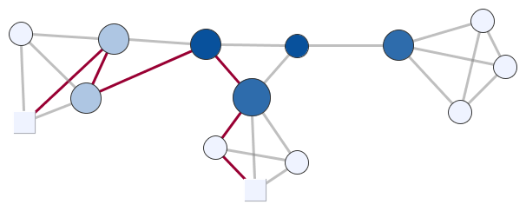
Shortest Paths
The length of a path is the number of links on that path.

Slide 122
Shortest Paths
The length of a path is the number of links on that path.

Slide 123

Shortest Paths
The distance between vertices is the length of the shortest path

Slide 124
Shortest Paths
The length of a path is the number of links on that path.
The distance between vertices is the length of the shortest path
The Betweenness of a vertex is the number of shortest paths passing through that vertex

Slide 125
Centrality
Network centrality measures try to describe the importance of a network.
Size ∝ Degree
Darker = Higher Betweenness
Notes:
Degree = width and height, betweenness = colour
networkcentralityexample.graphmlz
networkcentralityexampleSizeDeg-ColourBness.*

Slide 126
Path Length
The length of a path is the number of links on that path.
Path Length 6
Notes:
Degree = width and height, betweenness = colour
networkcentralityexample.graphmlz
networkcentralityexampleSizeDeg-ColourBness.*

Slide 127
Distance Between Vertices
The distance between vertices is the length of the shortest path.
Distance between
vertices = 4
Notes:
Degree = width and height, betweenness = colour
networkcentralityexample.graphmlz
networkcentralityexampleSizeDeg-ColourBness.*

Slide 128

Vertex Betweenness
The Betweenness of a vertex is the number of shortest paths passing through that vertex

Slide 129
Longest Path
Longest paths have little meaning for most networks as paths typically visit a large fraction of network
Longest Path
Length 9

Slide 130
Longest Path and DAG
Longest Path is the best approximation to the space-time geodesics in the Causal Set Models of Minkowskii space
[Brightwell & Gregory, 1991]
Also conjectured to be true of Causal Sets for general (curved) space-times

Slide 131
Longest Path and DAG
Longest Path (9)
Geodesic
Shortest
Path (4)
Edges of Light
Cones
(Poisson Point Process in
1+1 dimension Minkowskii space)

Slide 132

Box Space Representation of Journal Rankings
Node = Journal
Directed Edge
if journal has
better IF, EF
& CA
Height
=
minimum
longest
path
distance
to root
Top 1000
journals
used
Top 40 shown
worse
Notes:
C:\Users\time\OneDrive\Documents\RESEARCH\DAG\Ratings\ifefca_r1000_level49edit.*
Figure 2 DAG of top forty nine academic journal based on level where nodes with a similar vertical position have the same level. The colour and shape reflects the height, a similar measure to level. Nodes of the same colour or at roughly the same vertical position are placed in the same group. The higher the group the more highly rated the journal. Based on Impact Factor (2013), Eigenfactor (2013) and Combined altmetrics.com rating of the DAG formed from the top 1000 journals by ASR (average score rating).

Slide 133

Conclusions
Tim Evans, mperial College London
http://netplexity.org
Temporal Networks come in two types
  time on vertices or time on edges
Constraints on networks require new tools in network analysis.
  Transitive Reduction, Dimension, Longest Path
  Geometry
Significant differences revealed between different fields and different types of data.
Work done with: James Clough, Jamie Gollings, Tamar Loach

Slide 134
Time & Networks
Transitive Reduction
Dimension
Longest Path
Geometry
Summary

Slide 135
Time and Longest Path
Longest paths are well defined when a time is defined
- you never go backwards
Longest Path Length 5
TIME

Slide 136
Longest Path and DAG
Longest Path is the best approximation to the space-time geodesics in the Causal Set Models of Minkowskii space
[Brightwell & Gregory, 1991]
Also conjectured to be true of Causal Sets for general (curved) space-times

Slide 137
Longest Path and DAG
Longest Path (9)
Geodesic
Shortest
Path (4)
Edges of Light
Cones
(Poisson Point Process in
1+1 dimension Minkowskii space)

Slide 138
Small Example: DNA Citation Network
40 Key events (mostly single papers) in the development of the theory of DNA
Links are both direct citations and citations via an intermediary paper with a common author.
[Asimov 1962; Garfield, Sher, Torpie,1964;
Hummon & Dereian 1989]
Notes:
Garfield, E.; Sher, I. H. & Torpie, R. J.
The use of citation data in writing the history of science
DTIC Document, 1964
Review: Origin of the data on the DNA papers historiography.
Hummon, N. P. & Dereian, P.
Connectivity in a citation network: The development of DNA theory
Social Networks, Elsevier, 1989, 11, 39-63
Review: This paper applies network analysis to the DNA network. Includes main path analysis. Also has some nice summaries of the nodes.
20 - Avery et al 1944
21 - Chargaff 1947 - base pairs
22 - Chargaff 1950 - relative number of base pairs differs by species
27 - Watson and Crick 1953 - double helix - Nobel in 1962
32 - Ochoa 1955 - Nobel in 1959

Slide 139
DNA Citation Network
[Fig 1, Hummon & Dereian 1989]
Nobel
Watson &
Crick ‘53
27
Ochoa ‘55
32
Miescher
1871
TIME
Notes:
20 - Avery et al 1944
21 - Chargaff 1947 - base pairs
22 - Chargaff 1950 - relative number of base pairs differs by species
27 - Watson and Crick 1953 - double helix - Nobel in 1962
32 - Ochoa 1955 - Nobel in 1959

Slide 140
Shortest Path Betweenness for DNA Network
Size = Shortest Path Betweenness
Colour = Longest Path Betweenness
Notes:
20 - Avery et al 1944
21 - Chargaff 1947 - base pairs
22 - Chargaff 1950 - relative number of base pairs differs by species
27 - Watson and Crick 1953 - double helix - Nobel in 1962
32 - Ochoa 1955 - Nobel in 1959

Slide 141
Longest Path Betweenness for DNA Network
Size = Longest Path Betweenness
Colour = ditto
Notes:
JC (8/6/15 email):- So the colours are just the same as the sizes of the nodes with red=small=low_betweenness up to green=big=high_betweenness - its done by gephi and I think its a bit non-linear ie. things of different sizes can seem to have very similar colours but should be monotonic if that makes sense. I guess the brown ones are in the middle.
I think I sent you a couple of weeks ago the .gephi file so you should be able to open it from that. The positions I did by hand to try and get them to match the diagram in the Doreain paper where it originally came from but they are not necessarily 100% accurate.

Slide 142
Centrality for DAGs
Longest Path Centrality shows promise
Experimenting with other approaches
Comparing with “main path analysis” of bibliometrics field [Hummon & Dereian 1989]

Slide 143
Temporal Edge/Vertex Network Relationship
Types related by
Line Graph transformation
[c.f. Evans and Lambiotte, 2009, 2010;
Ahn et al. 2010]

Slide 144
Temporal Vertex -> Edge Network
Directed Line Graph transformation
A
7
6
7
6
B
4
C
5
5
4
D
3
2
1
3
1
2
E

Slide 145
Temporal Edge -> Vertex Network
(Directed) Line Graph transformation
Person
Person
E
4
D
4
Email
Chain
D
3
C
3
C
2
2
C
D
B
1
1
B
1
1
Time of email
A
Email

Slide 146
Temporal Spread vs. Temporal Events
Spreading on a geographical network is very different from temporal events network
A
2
A
y
B
1
B
C
1
DAG
C
D
1
D
E
0
x
E
Arrival time is shortest path
distance from source

Slide 147
Temporal Spread vs. Temporal Events
Same geographical network,
different source vertex
A
1
A
y
B
2
B
C
0
DAG
C
D
1
D
E
1
E
x
Arrival time is shortest path
distance from source

Slide 148
Temporal Spread vs. Temporal Events
Same underlying network, same process,
different source vertex ⇒ different DAG
A
A
B
B
A
B
D
C
C
D
D
or
E
C
E
E
DAG, source E
DAG, source C

Slide 149

Minkowskii Space
Future
timelike
time
space
Notes:
This comes from
JamesNetSciXWroclawLorentzianNetworkGeometry.pptx
in
C:\Users\time\OneDrive\Documents\RESEARCH\DAG\Talks\James-MDS-presentations-2016

Slide 150

Analysis of DAGs
Paths and Dimensions in Temporal Networks
Joana Teixeira
Third year project
Partner: Chon Lei (Jacky)
Supervisor: Dr Tim Evans
Notes:
These slides come from
JoanaRibeiroPresentation PDF (3-4).pptx
In
C:\Users\time\OneDrive\Documents\TEACHING\UG\PROJECTS\BScProj\DAG\DAG2015-16

Slide 151



Dimension Calculation
Longest Path is related to Dimension [1] via :
$\lim_{N→∞}{\frac{L_{max}}{L_{scale}}=m_{M}}$
$$L_{scale}=N^{1/D}$$
$N$ – number of nodes in interval
$L_{max}$– length of longest path
D – dimension of network
$m_{M}$ – maximal chain constant (limits presented in [1])
2D Minkowski – iterated 500 times
(1)
(2)
$$L_{max}$$
 | $$D$$ | $$m_{M}$$
Longest | 1.970 $±$ 0.006 | 1.808$±$0.021
Greedy | 2.057 $±$ 0.011 | 1.722$±$0.029
Number of nodes
[1] Bollobas, Brightwell (1991)
2. Results - Theoretical Model
Notes:
Generated networks with several N values and found longest and greedy time path. Plotted results and fitted func to the average. Used small N correction (no analytic proof) tried other fittings but decided this one was most meaningful given our N is relatively small (due to time constrains), so need a term, but b term very random (not enough data points).
Results fitted from average similar to results fitted from row data (SEE APPENDIX) chose to use average as easier to visualise, but any would be fine.
Values in Table for Minkowski space. Here just focus on2D M, but we did similar analysis for 3D M, 2D C and 3D C.
Mx min is value for greedy path, mx max limit for real longest path.
See appendix 1 for comparison of Large N vs all N values. See appendix 3 for comments on errors (comparison between three different samples)

Slide 152











Dimension Calculation
$$L_{max}=m_{x}{ N}^{1/2}$$
Limits for $m_{x}$ for Minkowski space given in [1]
$$L=m_{x}{ N}^{1/2}$$
2D Minkowski – iterated 500 times
 | $$m_{M} min$$ | $$m_{M} max$$
2D | 1.596 | 2.718
Path length
$m_{M}$ values obtained from our model for large N; D=2
Path length
$$L/{ N}^{1/2}$$
$$L_{max}/{ N}^{1/2}$$
 | $$m_{M} Greedy$$ | $$m_{M} Longest$$
2D | 1.571 $±$ 0.006 | 1.901 $±$ 0.004
Number of nodes
Number of nodes
1/N
1/N
Fitting Function:
$L_{max}=m_{M}{ N}^{1/2} ⇒\frac{L_{max}}{{ N}^{1/2}}=m_{M} (Constant$)
$$\frac{L_{max}}{{ N}^{1/2}}=m_{M}+α\frac{1}{N}$$
[1] Bollobas, Brightwell (1991)
2. Results - Theoretical Model
Notes:
Generated networks with several N values and found longest and greedy time path. Plotted results and fitted func to the average. Used small N correction (no analytic proof) tried other fittings but decided this one was most meaningful given our N is relatively small (due to time constrains), so need a term, but b term very random (not enough data points).
Results fitted from average similar to results fitted from row data (SEE APPENDIX) chose to use average as easier to visualise, but any would be fine.
Values in Table for Minkowski space. Here just focus on2D M, but we did similar analysis for 3D M, 2D C and 3D C.
Mx min is value for greedy path, mx max limit for real longest path.
See appendix 1 for comparison of Large N vs all N values. See appendix 3 for comments on errors (comparison between three different samples)
Longest Path:
$m_{x}$=1.901 $±$ 0.004
D= 2
CHANGE FIGURE TO THE ONE WITH OTHER FITTING!

